Slide 1
Middle School is coming
Grace’s ministry through the teenage years

Slide 2
Began at Baptism

Slide 3
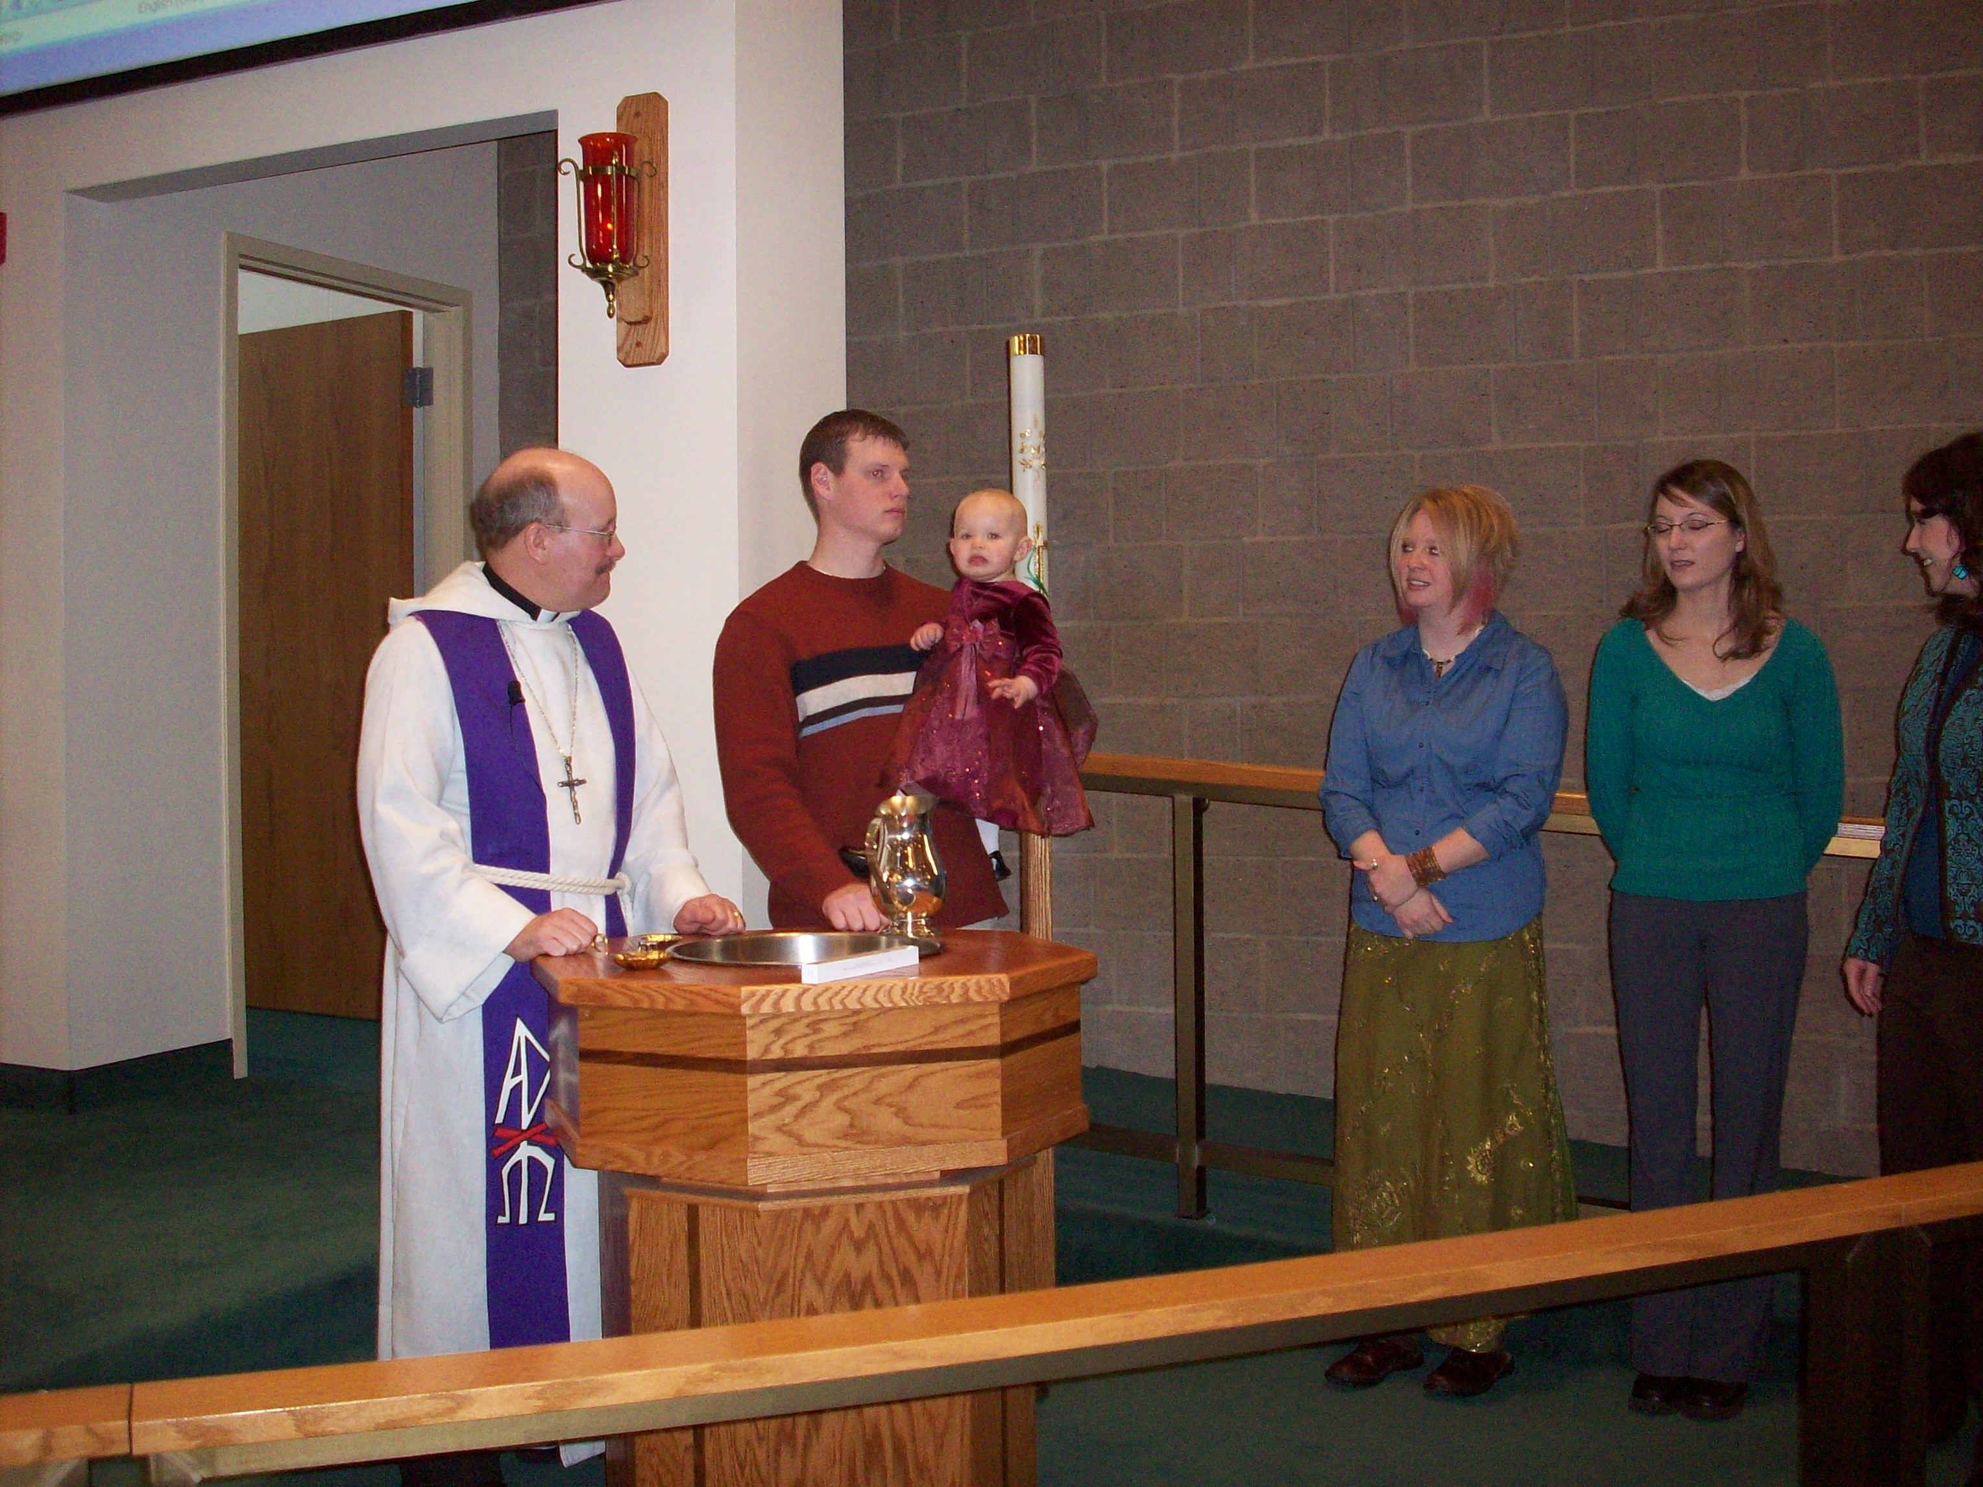
Baptisms

Slide 4
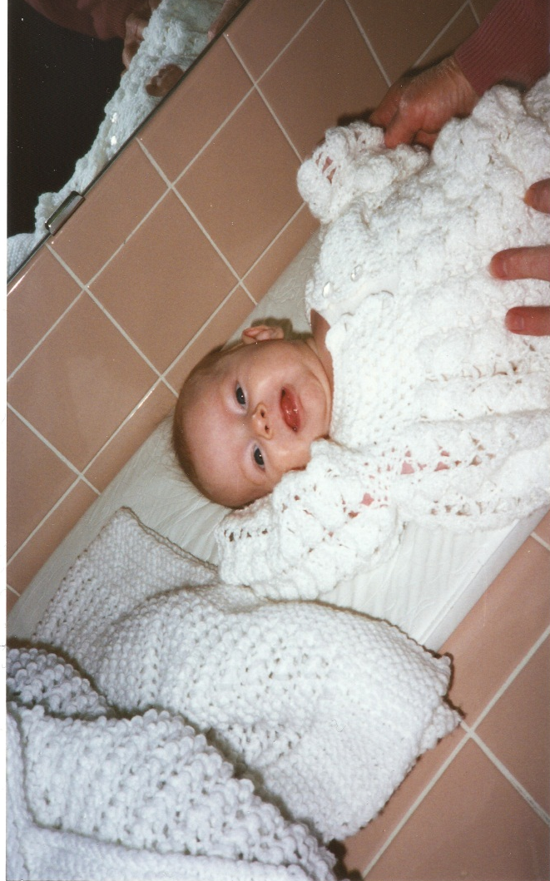
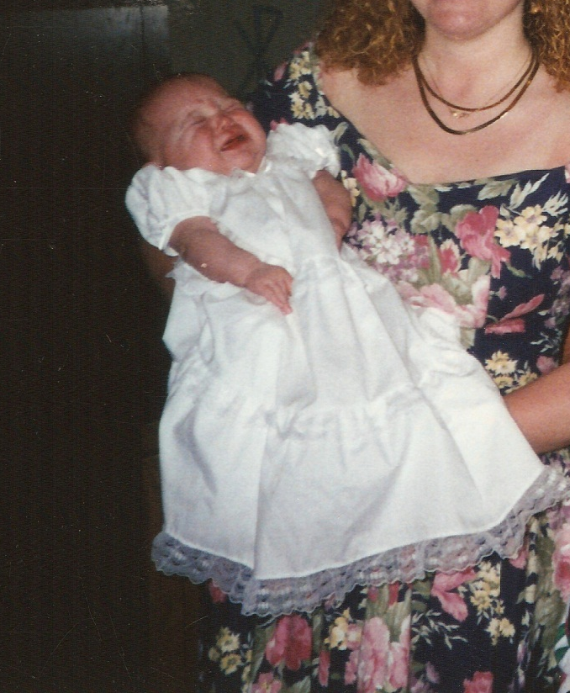
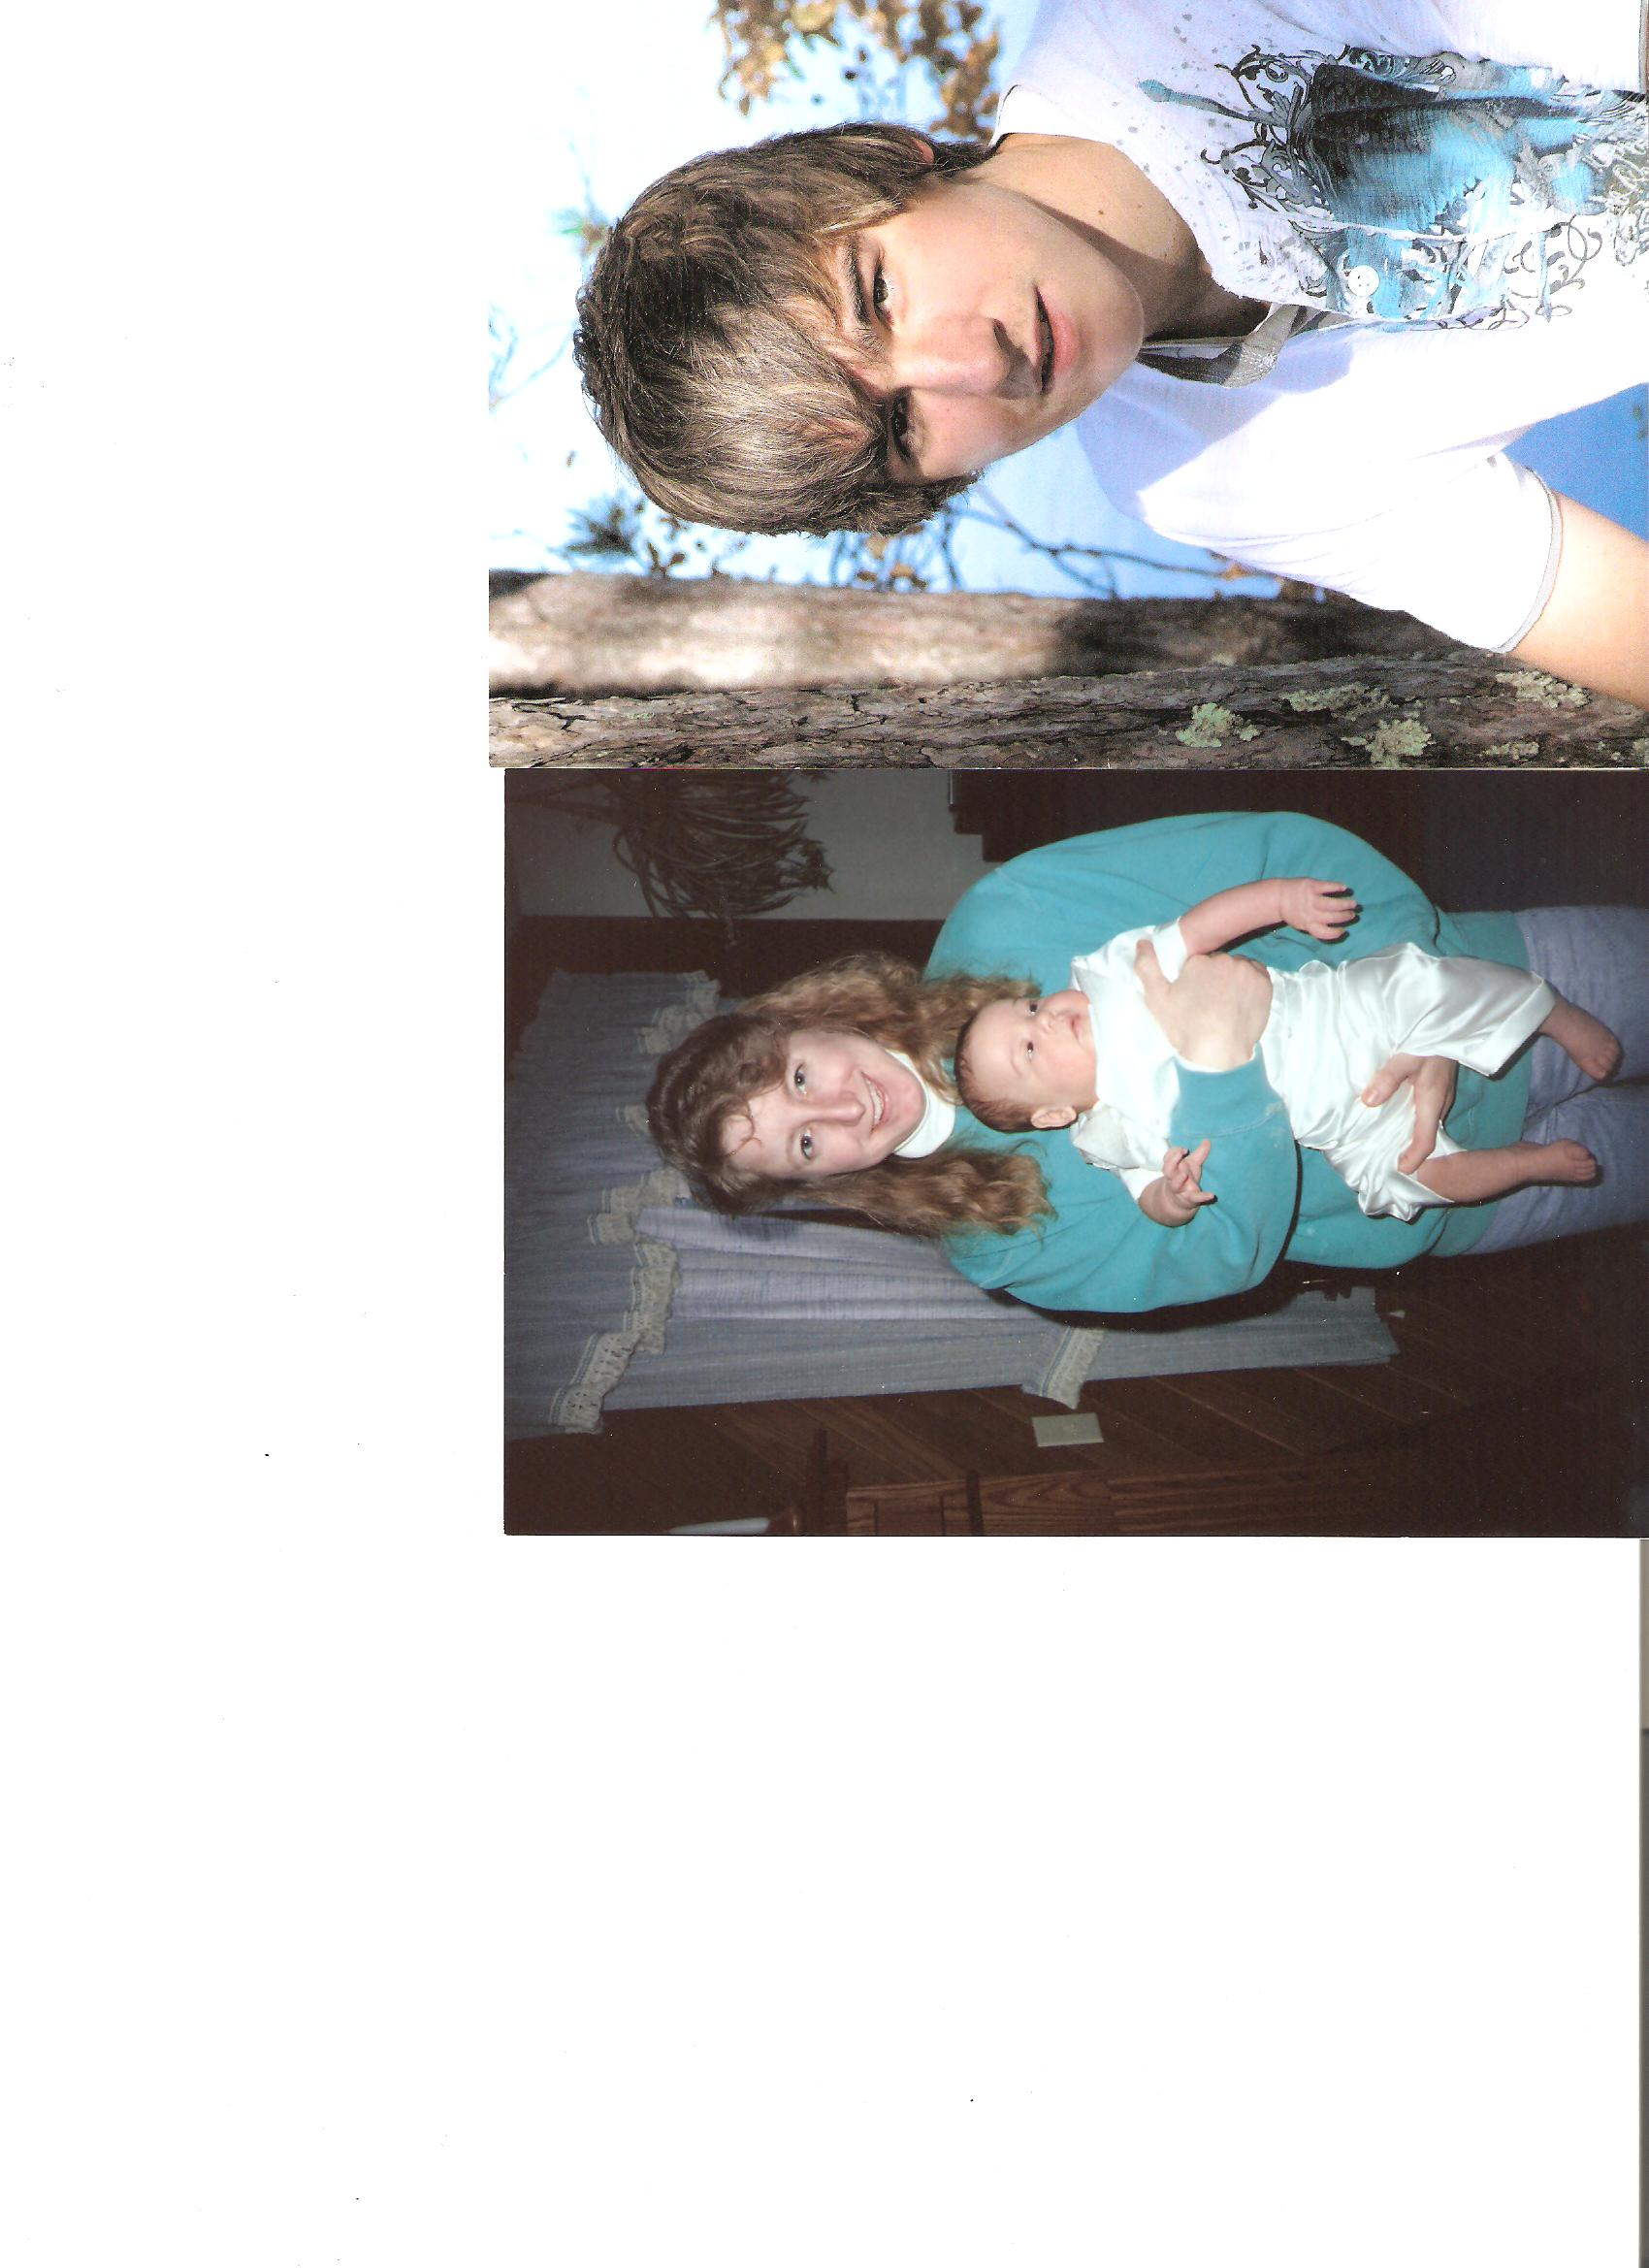

Slide 5
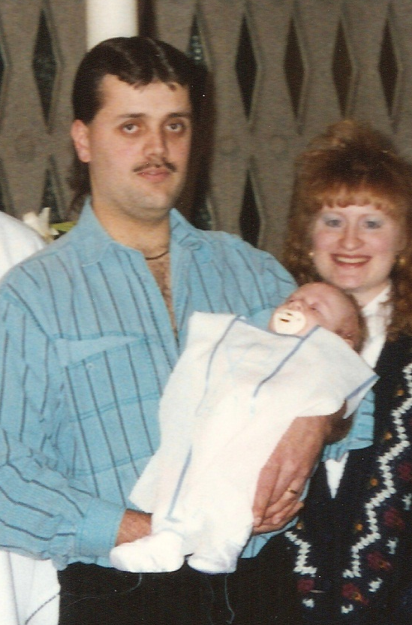
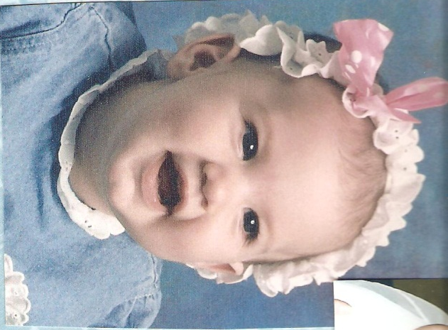
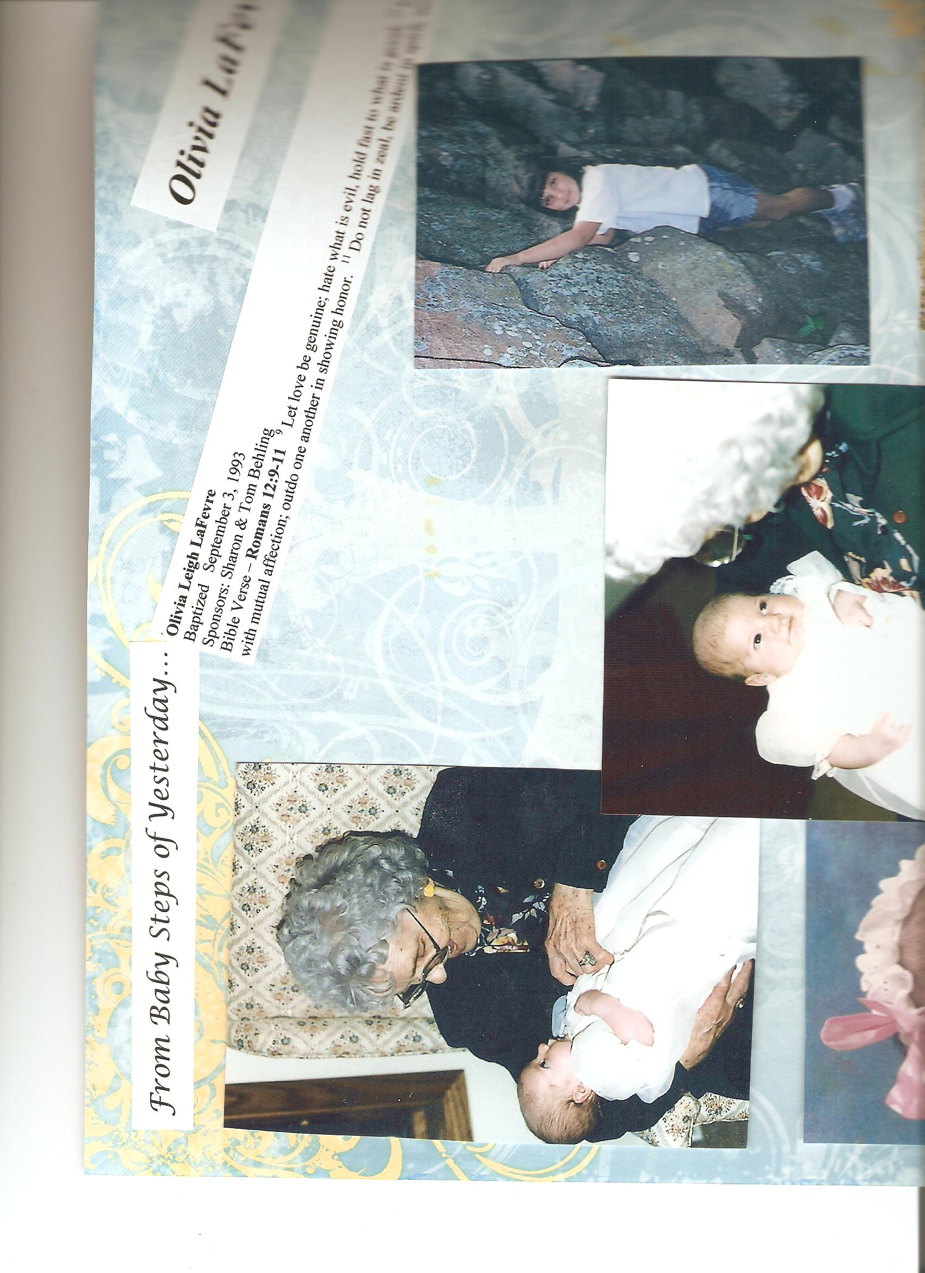
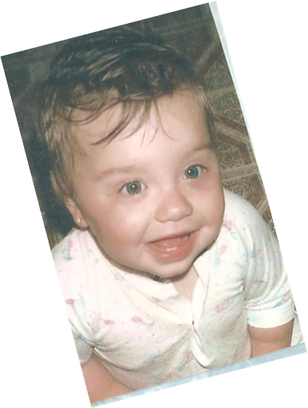
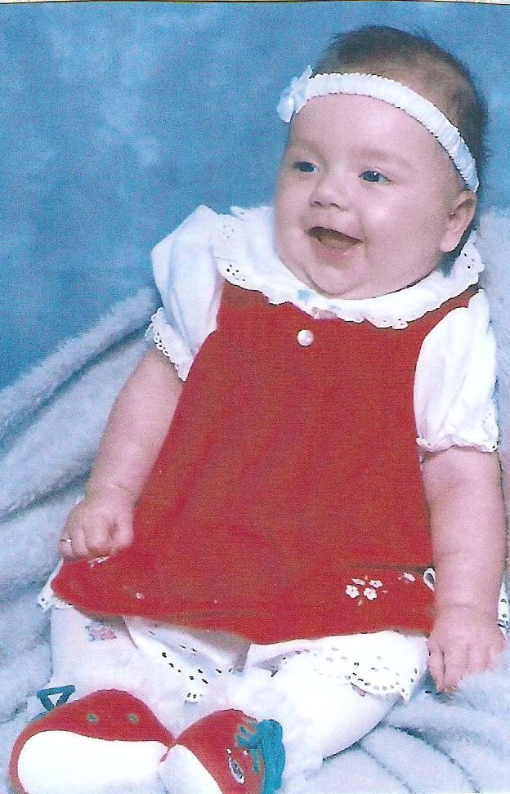

Slide 6
Baby ,Toddler,
Entering School

Slide 7
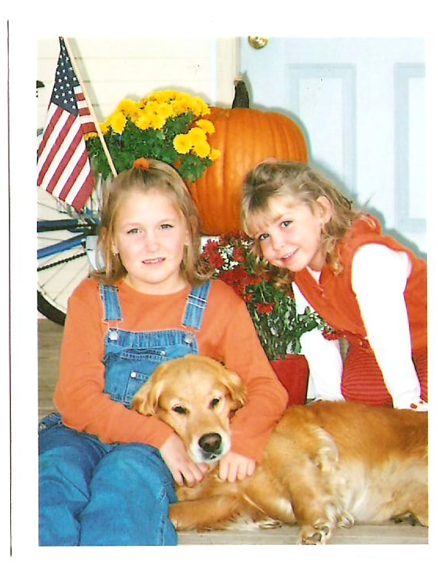
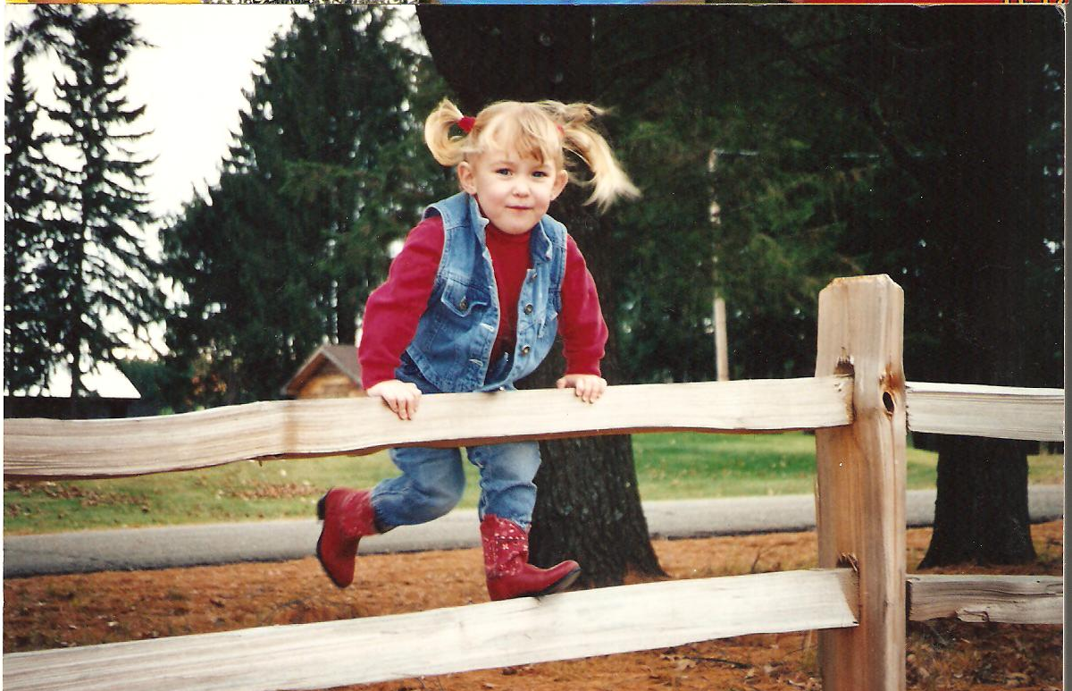
Growing in life & faith

Slide 8
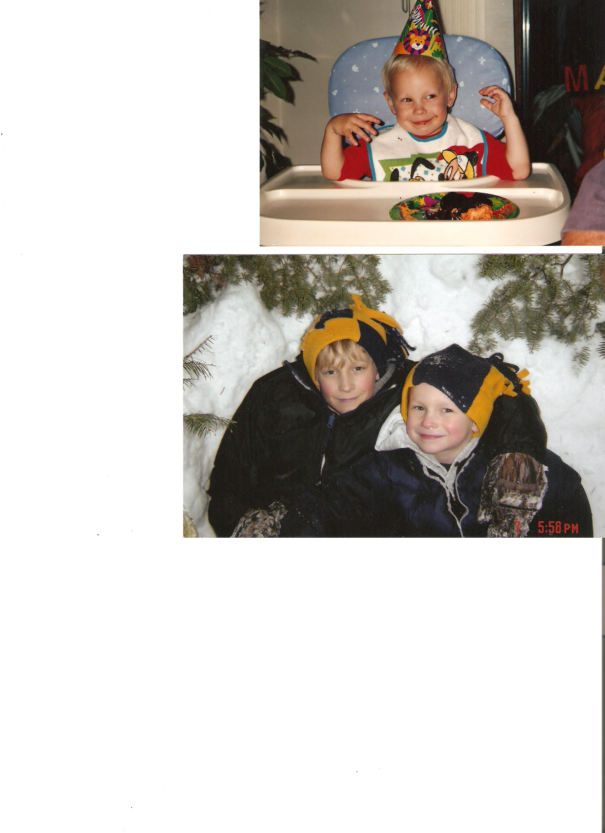


Slide 9
Next Step:
Elementary

Slide 10
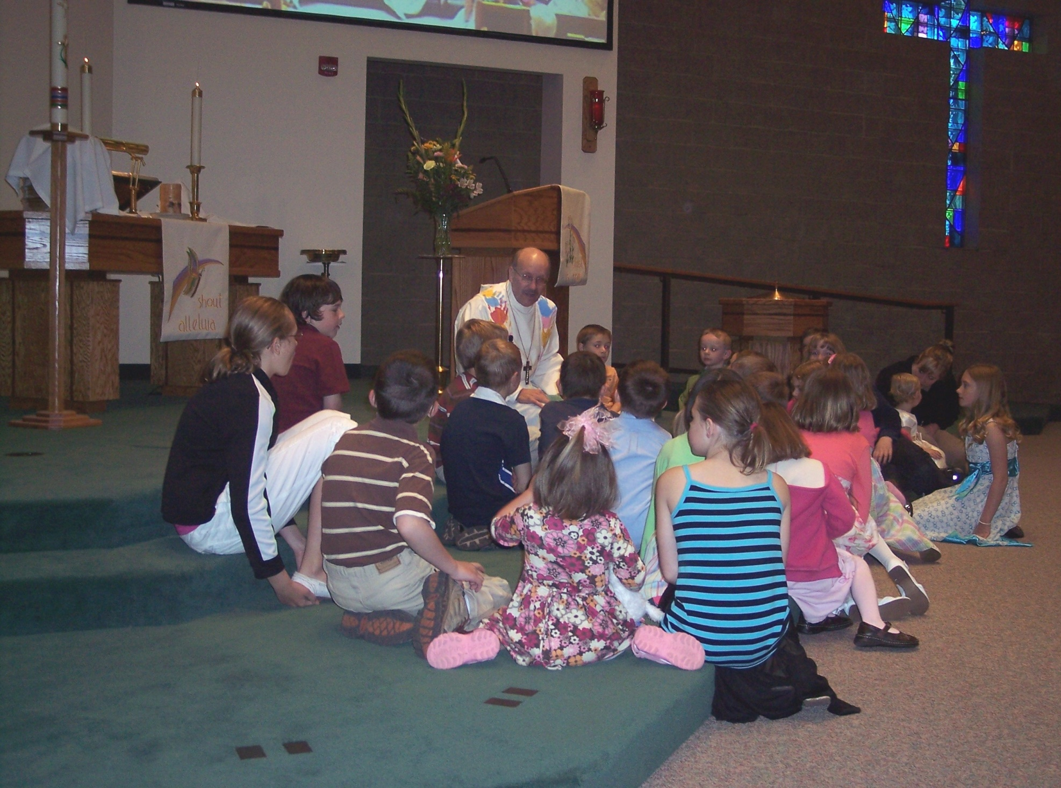
Children’s Messages

Slide 11
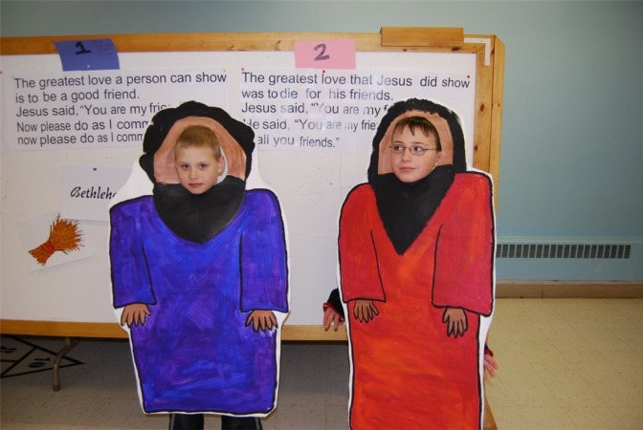
Sunday School

Slide 12
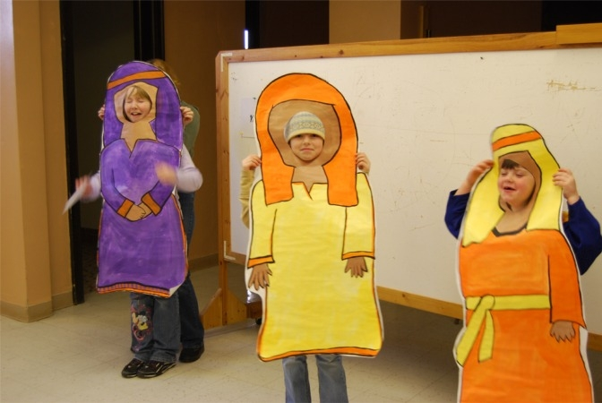

Slide 13
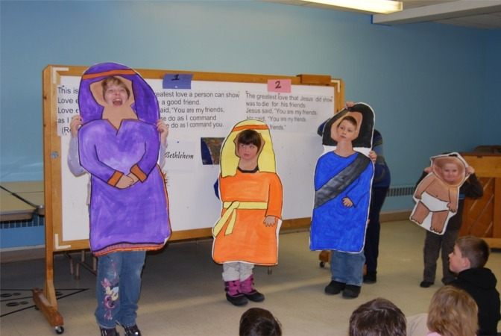

Slide 14
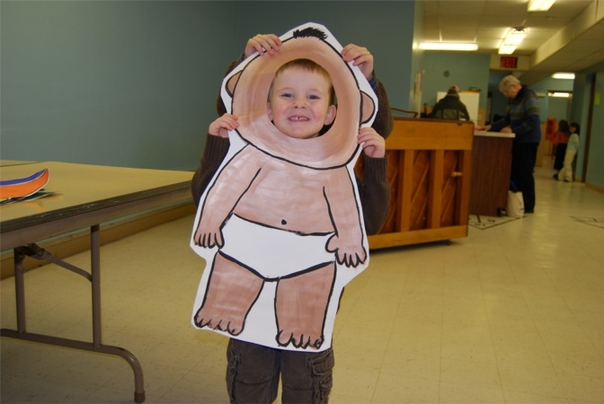

Slide 15
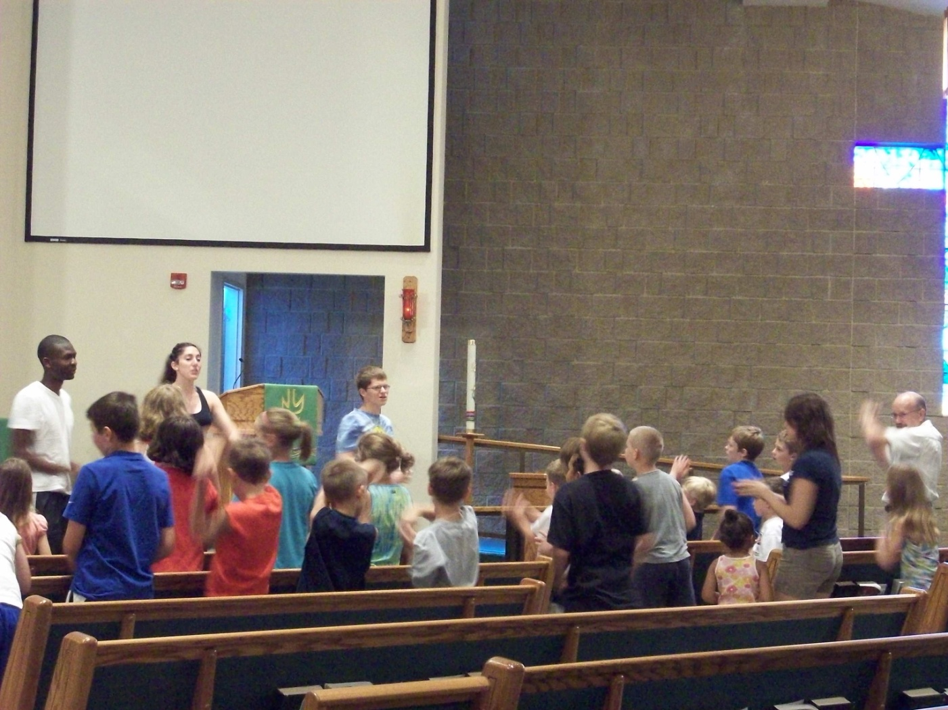
Day Camp

Slide 16
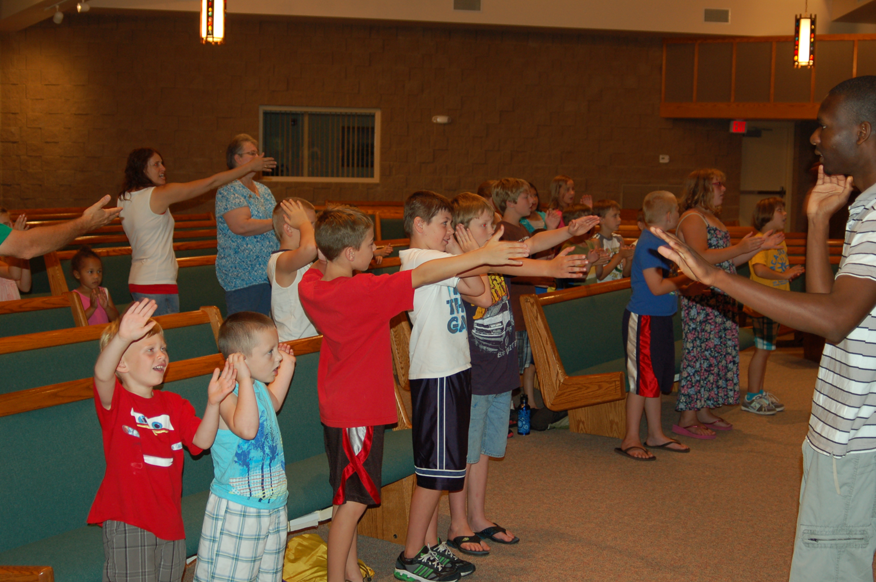
Day Camp 2011

Slide 17

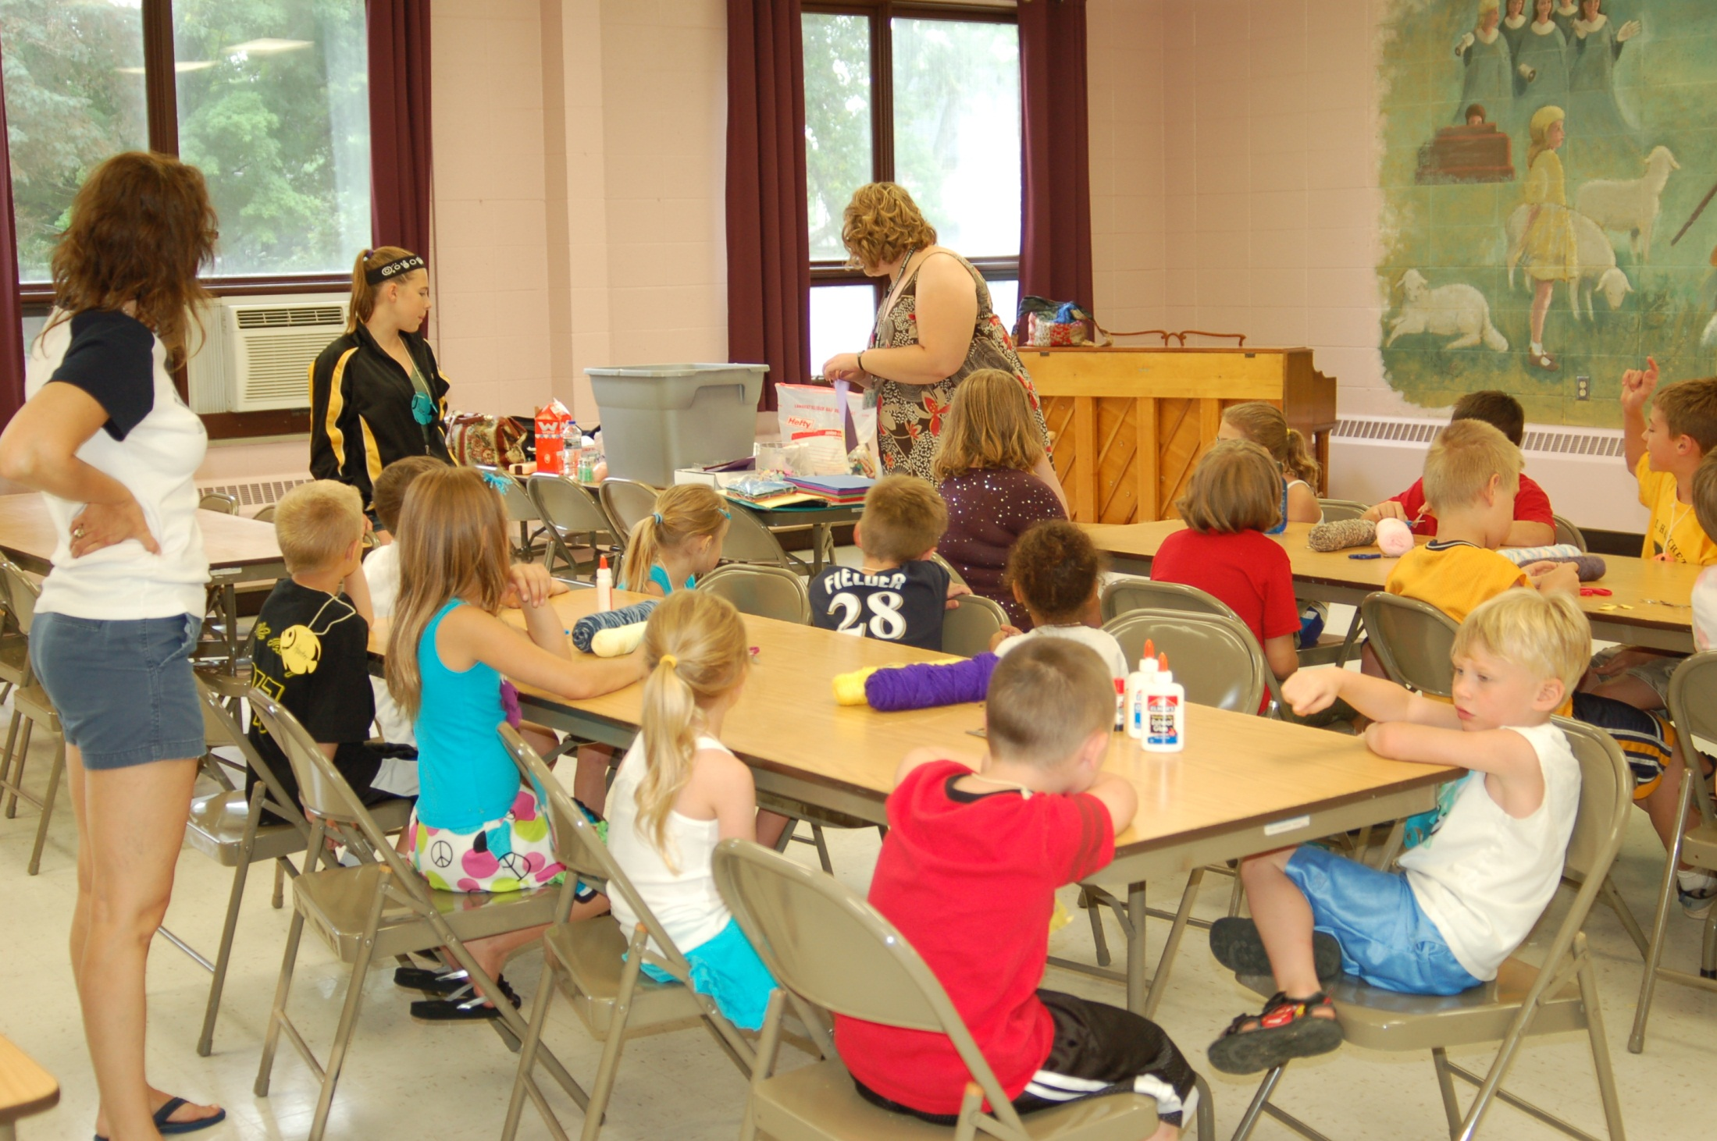

Slide 18
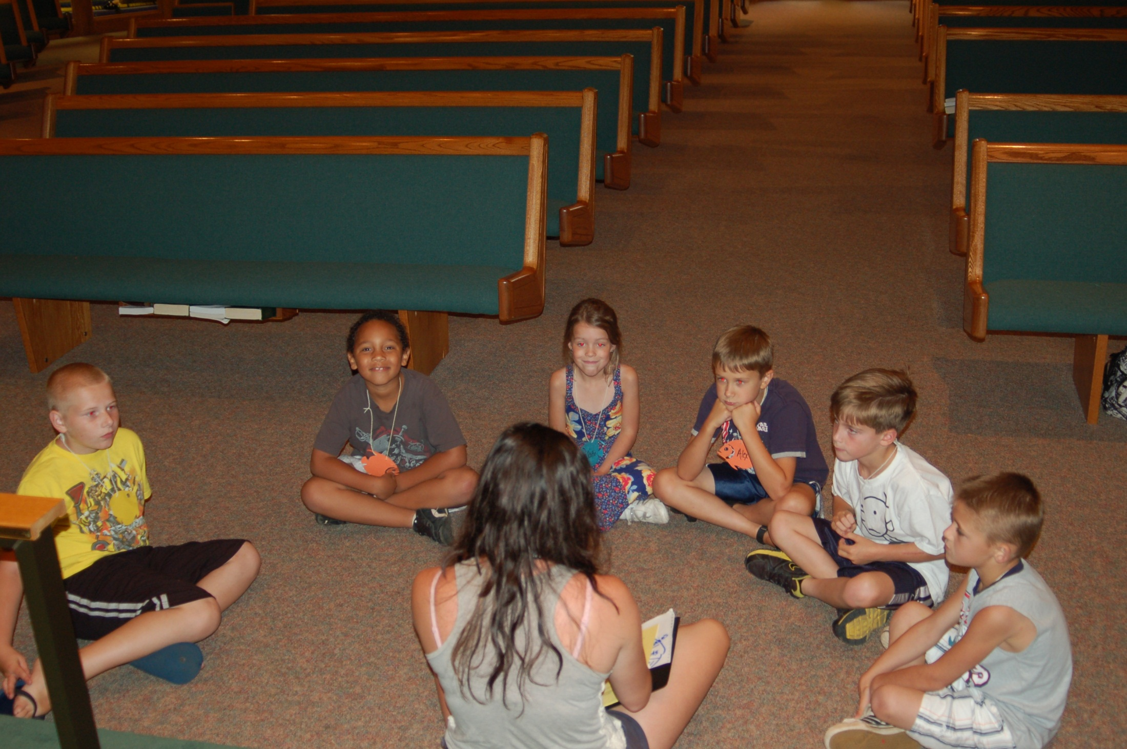

Slide 19

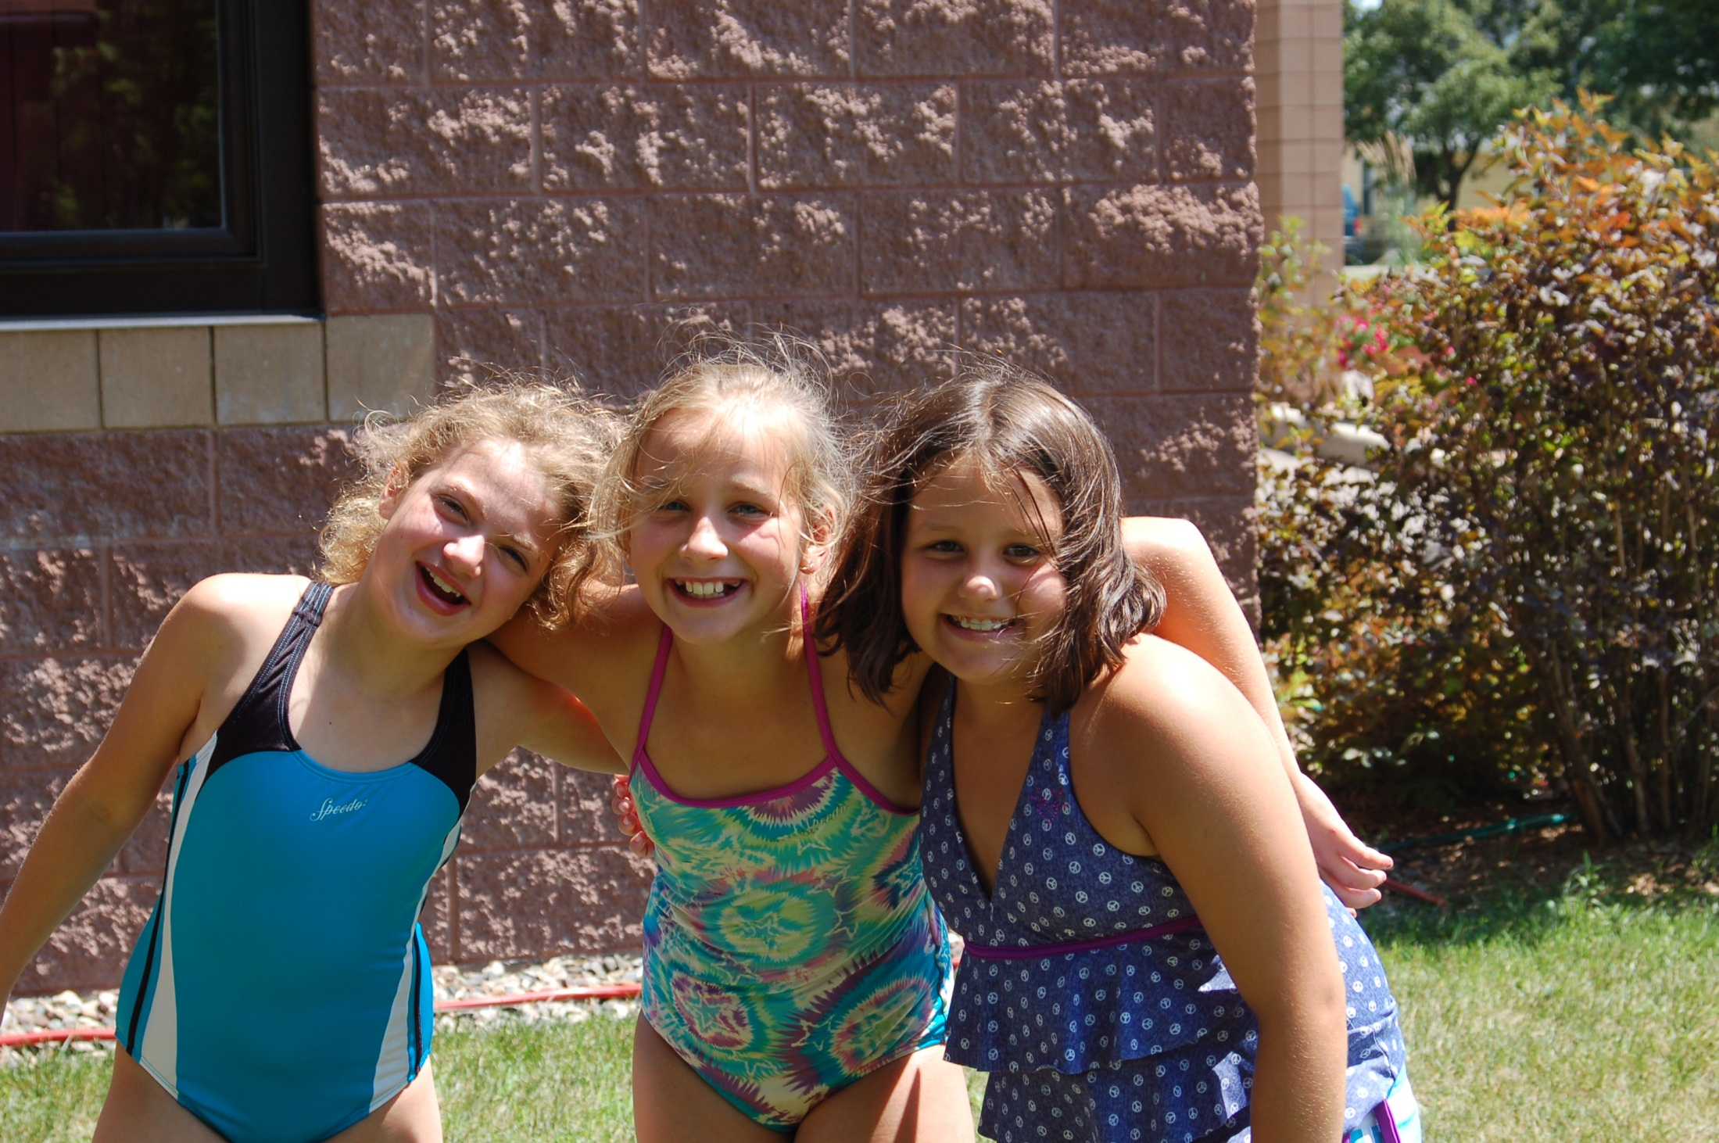

Slide 20
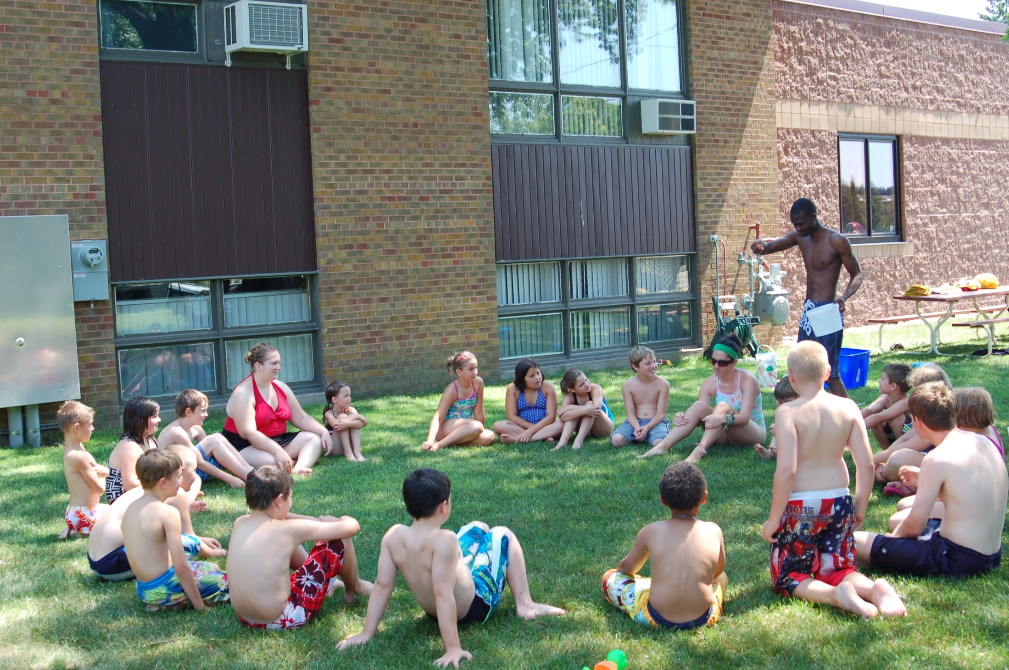

Slide 21

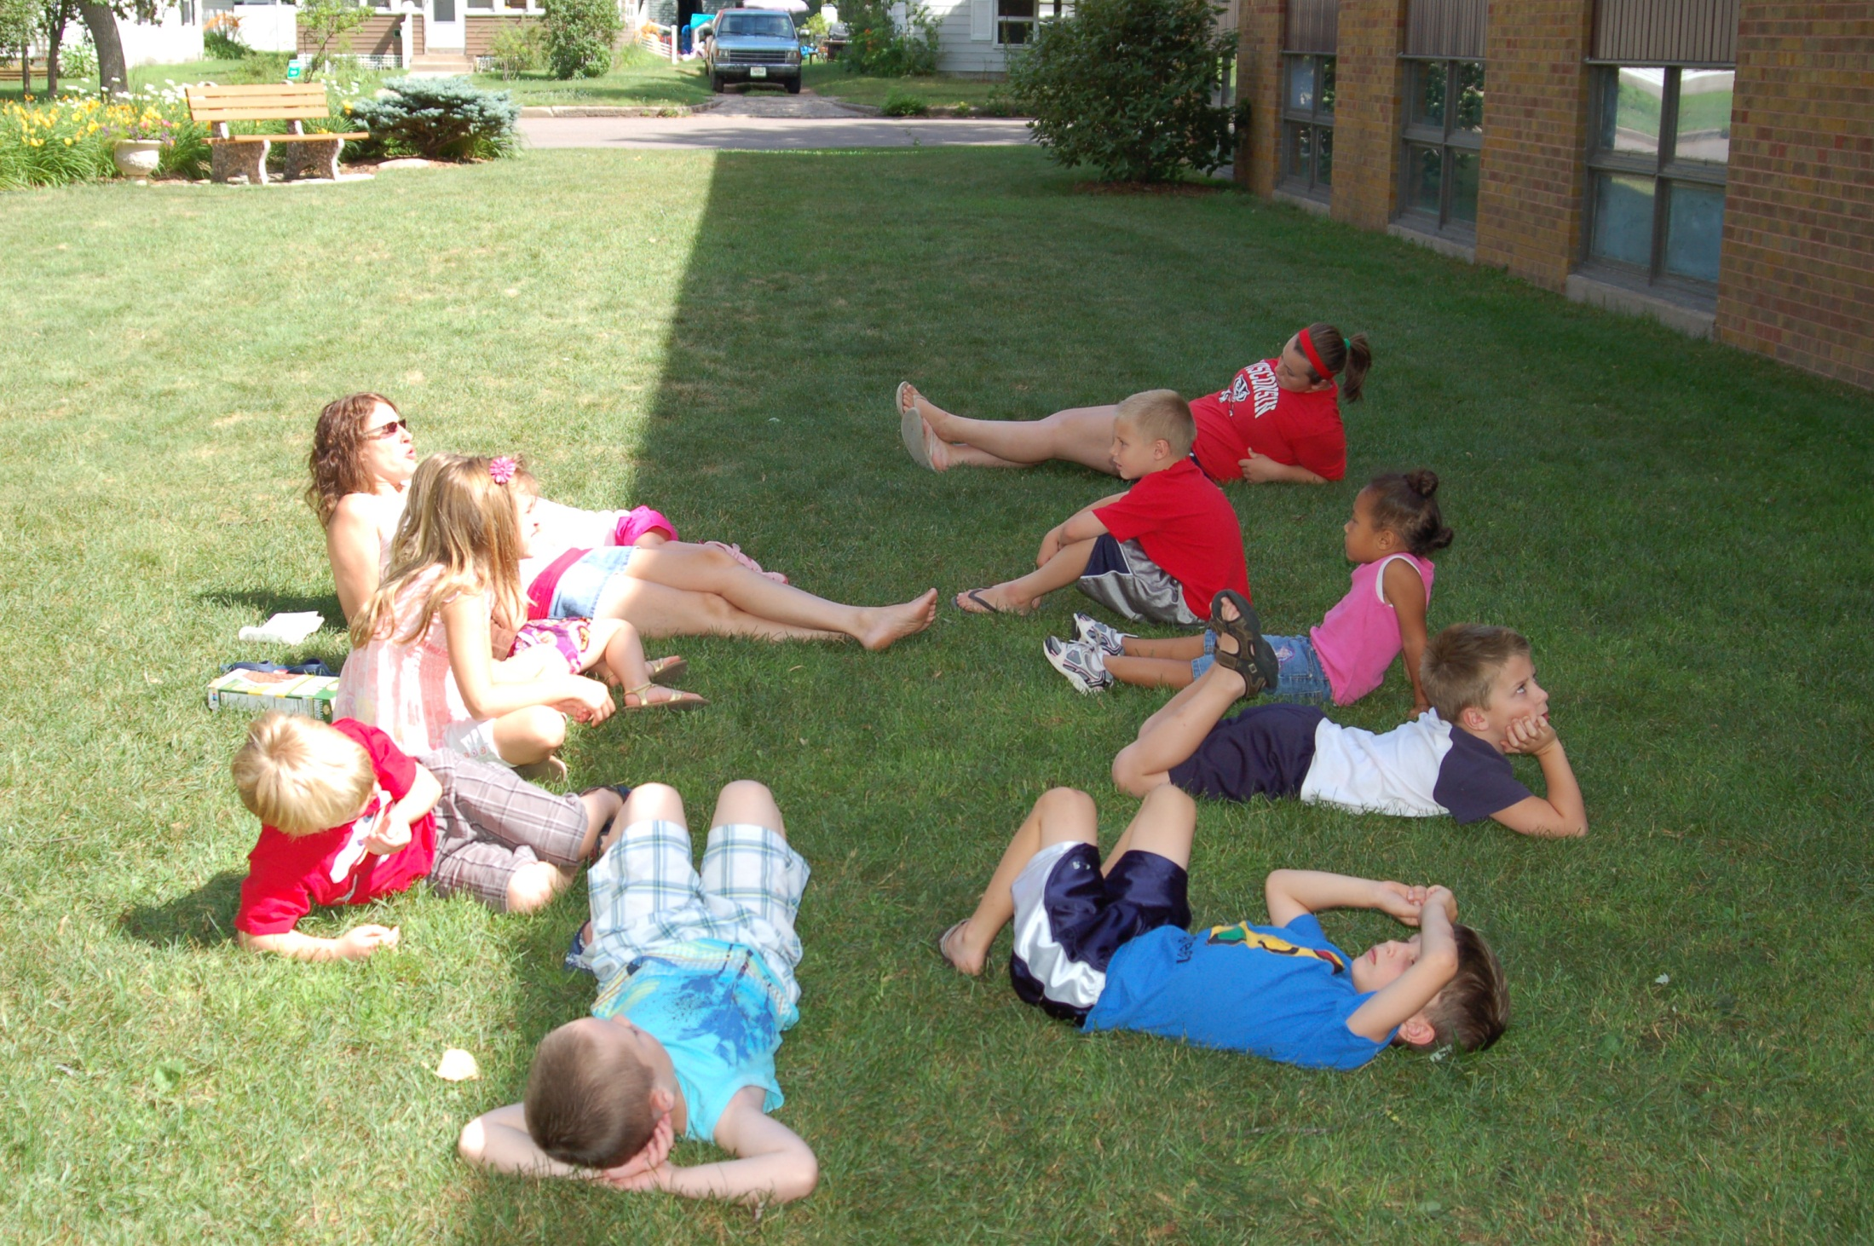

Slide 22
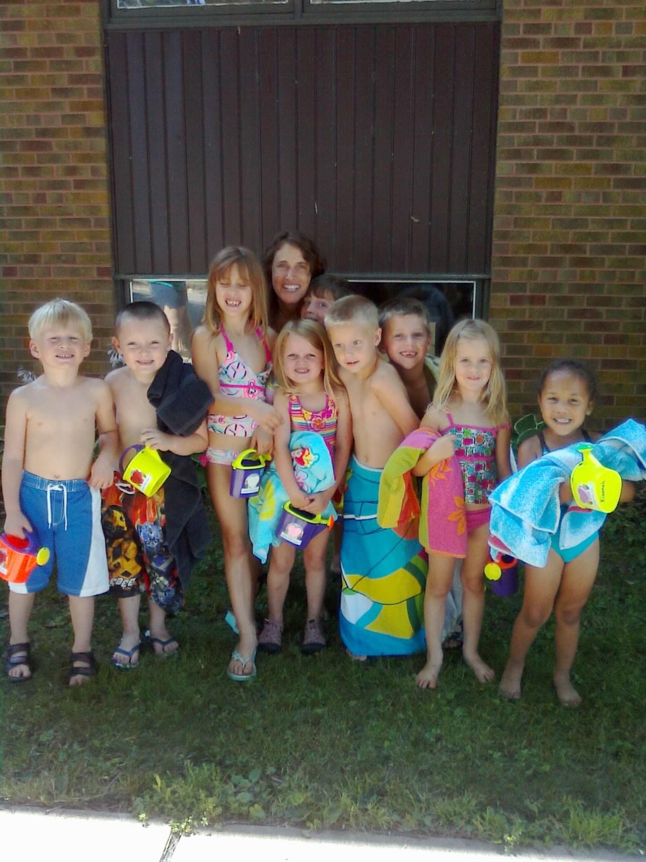

Slide 23

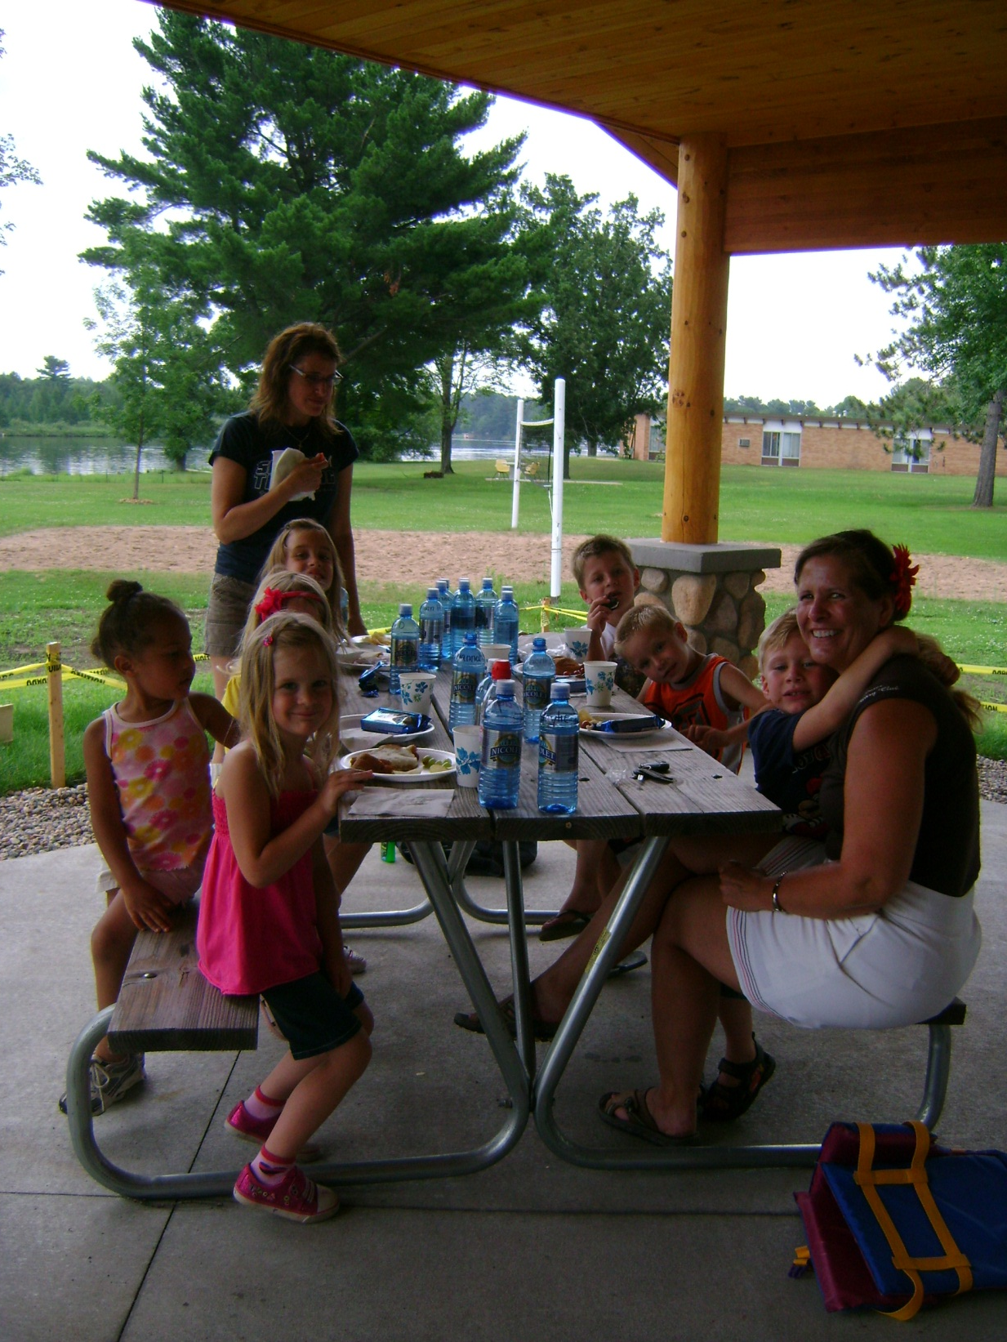

Slide 24
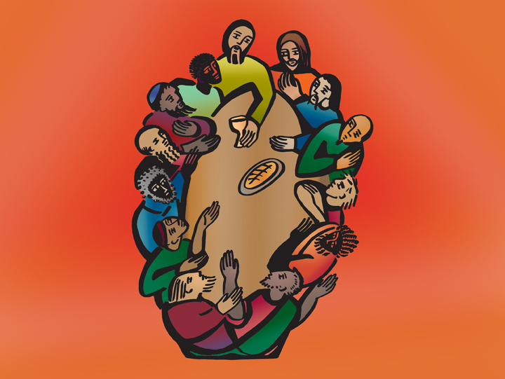
Receiving First Communion
Notes:
From ICON TWO FOR PROJECTION, copyright 2005 Augsburg Fortress. Used by permission.

Slide 25
Another Step
The Teenage Years are about to begin

Slide 26

We gather around the table to be reminded
God wants to lead us through all the years.
Notes:
From ICON TWO FOR PROJECTION, copyright 2005 Augsburg Fortress. Used by permission.

Slide 27

Notes:
From ICON TWO FOR PROJECTION, copyright 2005 Augsburg Fortress. Used by permission.

Slide 28

Jesus is the Lamb of God who sets us free!
Notes:
From ICON TWO FOR PROJECTION, copyright 2005 Augsburg Fortress. Used by permission.

Slide 29
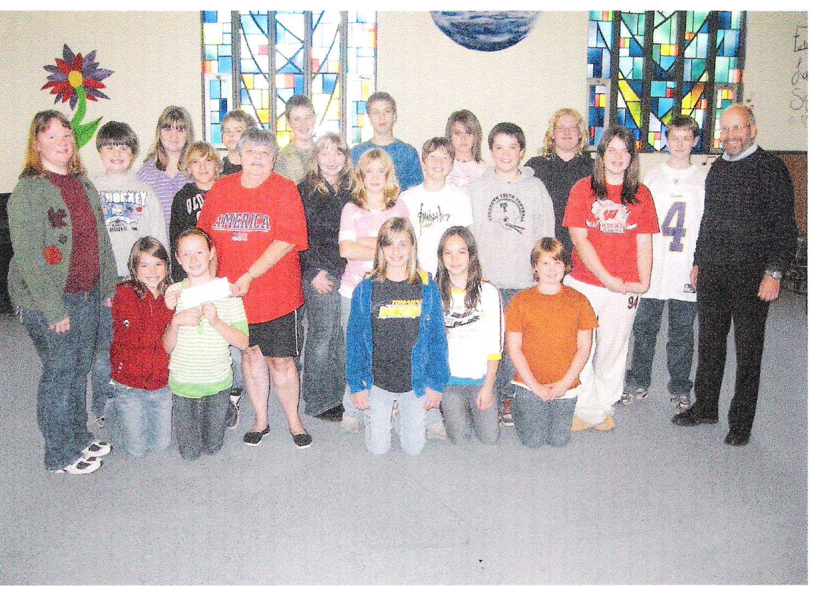
Wednesday After School

Slide 30
Do you know more than a
6th grader?
This is some of what 6-7th are learning in After-School Time.

Slide 31
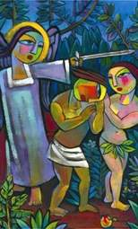
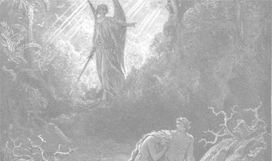
Read Genesis 3:1-7.
It is the classic story about the “Fall”, and human nature.
finkmania
(Click to continue)

Slide 32
In the classic Bible story of Genesis 3, the “Fall” happened when:
A snake tricked Eve into eating an apple,
A snake tricked Eve into disobeying God and eating an unknown fruit from the Tree of the Knowledge of Good and Evil,
Neither A nor B,
The summer was over
finkmania
(Click to continue)

Slide 33
In the classic Bible story of Genesis 3, the “Fall” happened when:
A snake tricked Eve into eating an apple,
A snake tricked Eve into disobeying God and eating an unknown fruit from the Tree of the Knowledge of Good and Evil,
Neither A nor B,
The summer was over
finkmania
(Click to continue)

Slide 34
Read Genesis 2:15-17.
What responsibility did God give?
finkmania
(Click to continue)

Slide 35
In Genesis 2:15-17, what responsibility did God give:
They could not touch trees,
They could not eat,
Only one tree they could not eat,
There was no limit – they could do anything!
finkmania
(Click to continue)

Slide 36
In Genesis 2:15-17, what responsibility did God give:
They could not touch trees,
They could not eat,
Only one tree they could not eat,
There was no limit – they could do anything!
finkmania
(Click to continue)

Slide 37
Read Genesis 2:15-17.
What consequence did God say would happen?
finkmania
(Click to continue)

Slide 38
In Genesis 2:15-17, what consequence did God say would happen:
They would be wise,
It would be good food,
It was good to look at,
They would die!
finkmania
(Click to continue)

Slide 39
In Genesis 2:15-17, what consequence did God say would happen:
They would be wise,
It would be good food,
It was good to look at,
They would die!
finkmania
(Click to continue)

Slide 40
Read Genesis 2:17 & 3:5.
What is it about this “tree of knowledge of good and evil?
finkmania
(Click to continue)

Slide 41
Read Genesis 2:17 & 3:5.
What is it about this “tree of knowledge of good and evil?
It tasted horrible,
God does not want us enjoying good things,
God purposely makes trouble,
We are not puppets; God gives us the possibility to “decide” for ourselves what is good and what is evil.
finkmania
(Click to continue)

Slide 42
Read Genesis 2:17 & 3:5.
What is it about this “tree of knowledge of good and evil?
It tasted horrible,
God does not want us enjoying good things,
God purposely makes trouble,
We are not puppets; God gives us the possibility to “decide” for ourselves what is good and what is evil.
finkmania
(Click to continue)

Slide 43
Who is the sneaky snake in Genesis 3?
finkmania
(Click to continue)

Slide 44
The sneaky snake who tempted Eve to take the fruit really was actually:
A sports agent,
Lord Voldemort in disguise,
Satan in disguise,
Just your average talking snake
finkmania
(Click to continue)

Slide 45
The sneaky snake who tempted Eve to take the fruit really was actually:
A sports agent,
Lord Voldemort in disguise,
Satan in disguise,
Just your average talking snake
finkmania
(Click to continue)

Slide 46
Read Genesis 3:1.
What is the first thing the snake tempted Eve to do?
finkmania
(Click to continue)

Slide 47
The first thing the snake tempted Eve to do was to:
Buy duct tape and thick plastic,
Put on some slacks,
Take a bath,
Doubt God
finkmania
(Click to continue)

Slide 48
The first thing the snake tempted Eve to do was to:
Buy duct tape and thick plastic,
Put on some slacks,
Take a bath,
Doubt God
finkmania
(Click to continue)

Slide 49
Read Genesis 3:4-5.
What did the serpent tell Eve that eating of the forbidden fruit would do?
finkmania
(Click to continue)

Slide 50
In Genesis 3, the serpent told Eve that eating of the forbidden fruit would:
Make her like God,
Allow her to know good from evil,
Not lead to her death,
All of the above, and isn’t Satan just the biggest liar around?
finkmania
(Click to continue)

Slide 51
In Genesis 3, the serpent told Eve that eating of the forbidden fruit would:
Make her like God,
Allow her to know good from evil,
Not lead to her death,
All of the above, and isn’t Satan just the biggest liar around?
finkmania
(Click to continue)

Slide 52
Read Genesis 3:5-6.
What were the three reasons the woman ate the fruit?
finkmania
(Click to continue)

Slide 53
In Genesis 3:5-6, what were the three reasons the woman ate the fruit:
Their eyes would be opened,
They would be like god,
They would know good &evil,
All of the above
finkmania
(Click to continue)

Slide 54
In Genesis 3:5-6, what were the three reasons the woman ate the fruit:
Their eyes would be opened,
They would be like god,
They would know good &evil,
All of the above
finkmania
(Click to continue)

Slide 55
Do it together:
Family style

Slide 56

Camp Forest Springs
If you missed this year!
Plan for 2013 - Sunday, 1-5pm

Slide 57
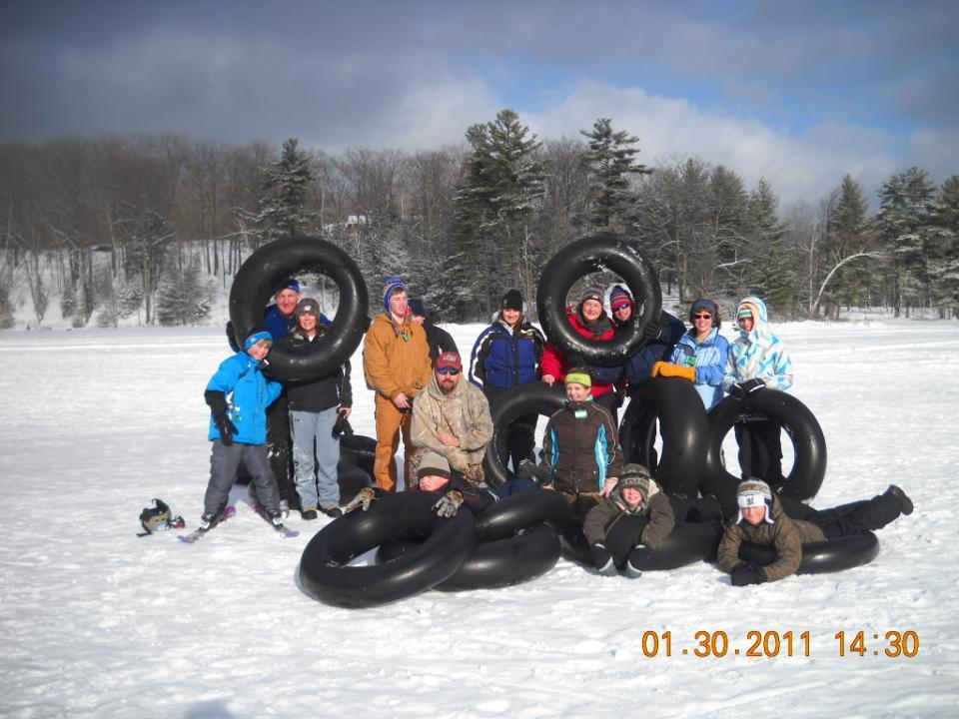

Slide 58
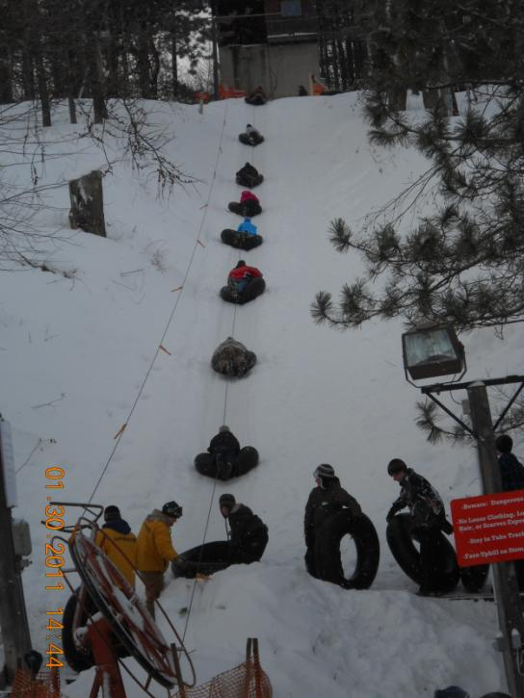

Slide 59
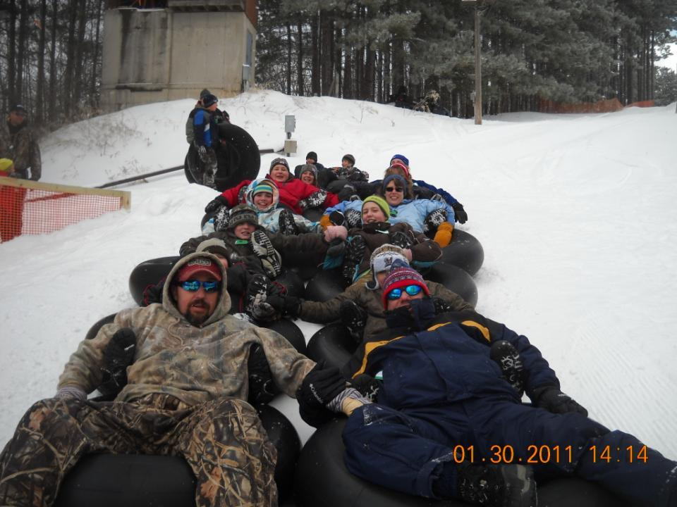

Slide 60
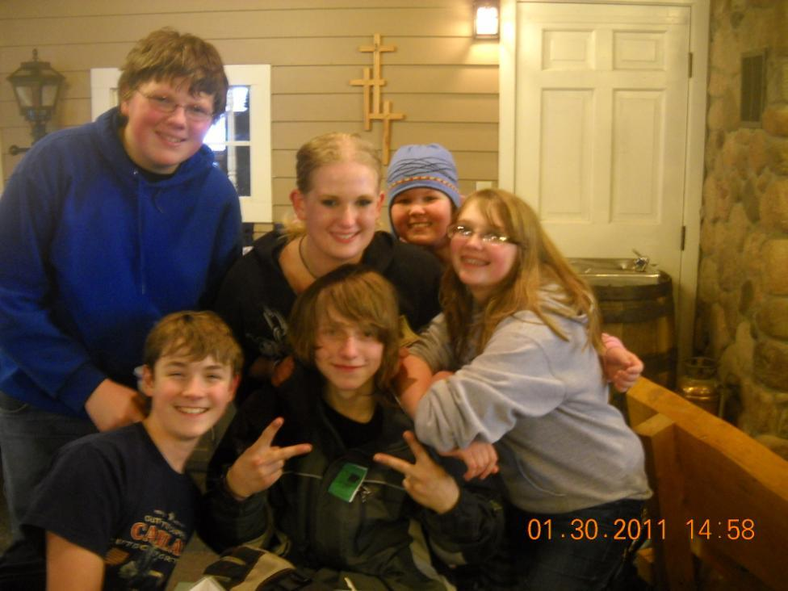

Slide 61
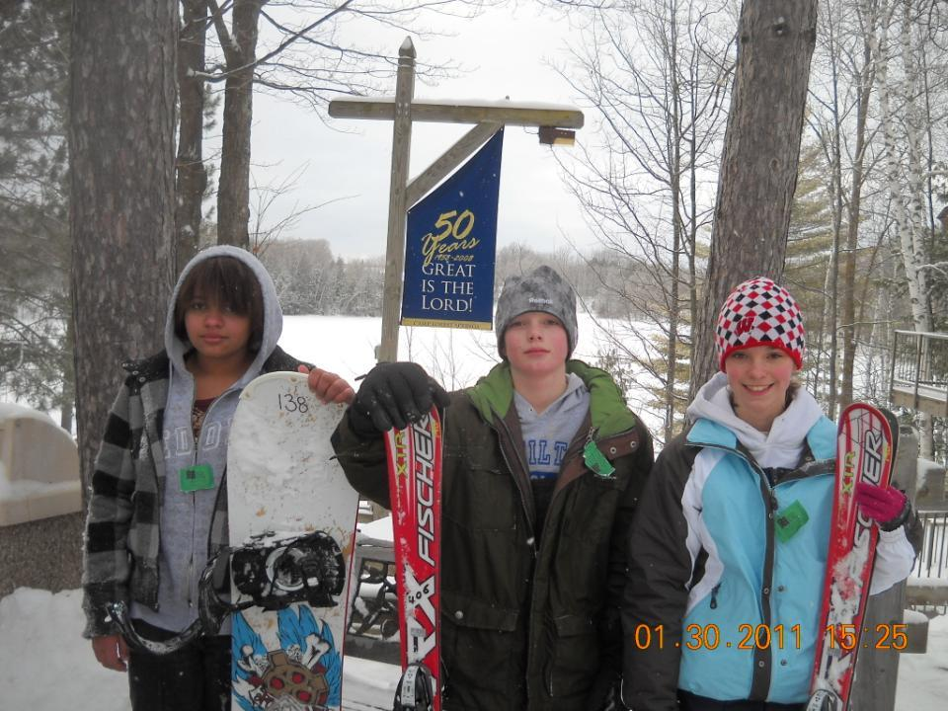

Slide 62
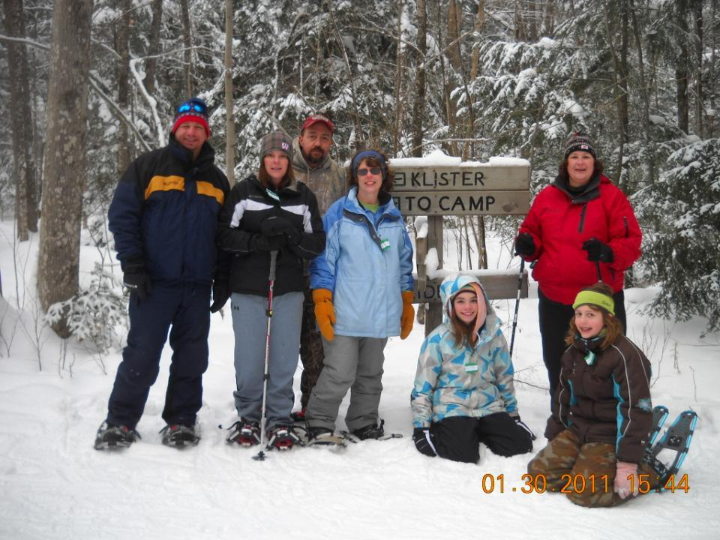

Slide 63
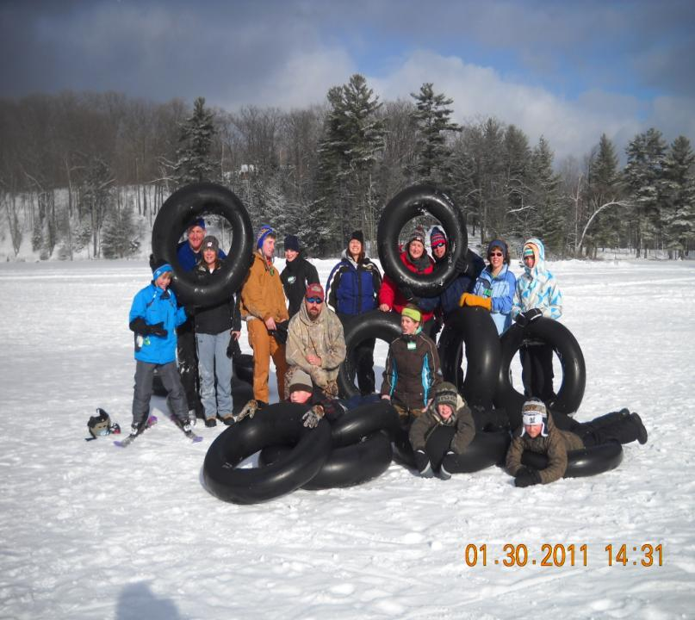
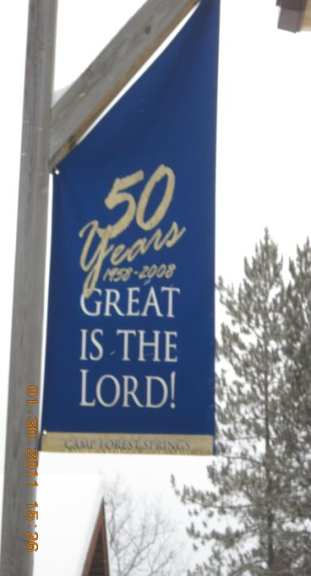

Slide 64
Remember:
Family style

Slide 65
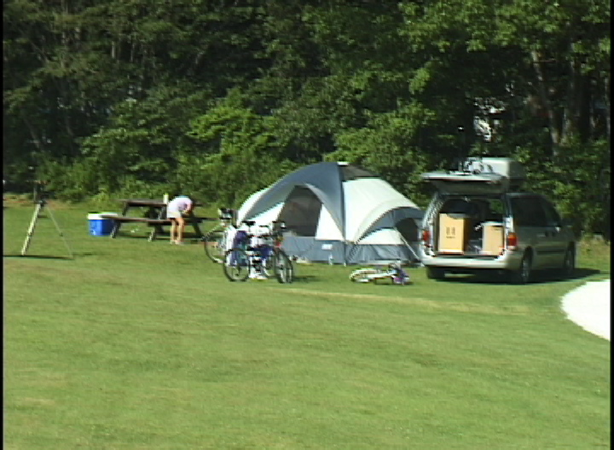
Car Camping

Slide 66
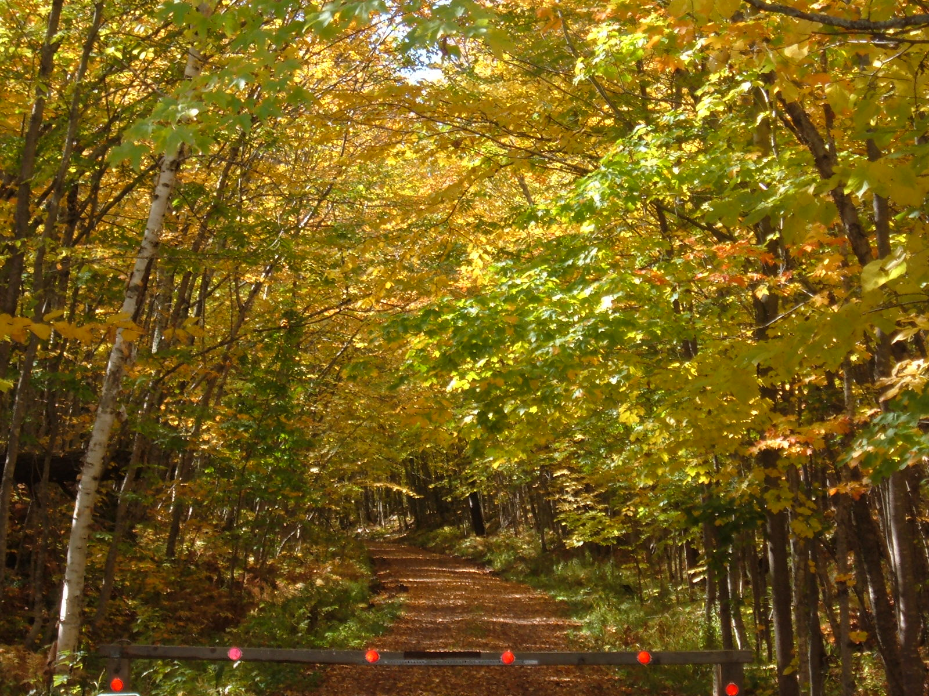
Porcupine Mountains

Slide 67
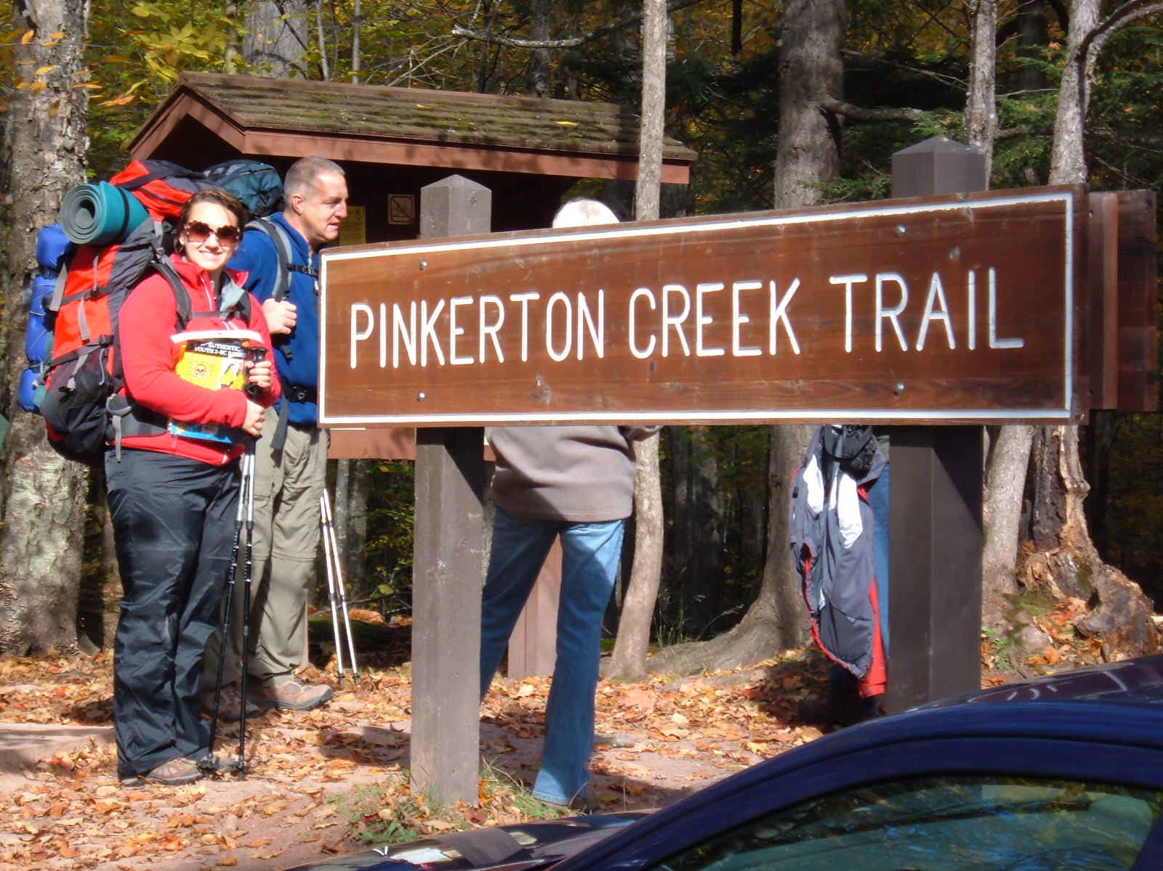

Slide 68
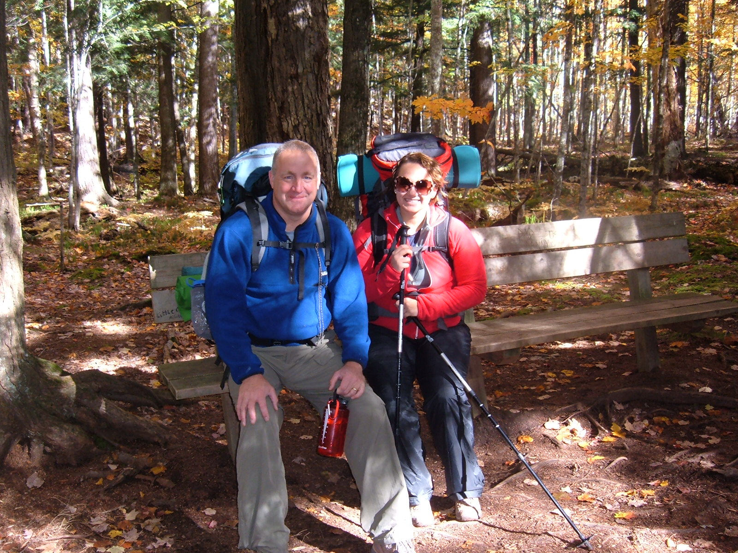

Slide 69
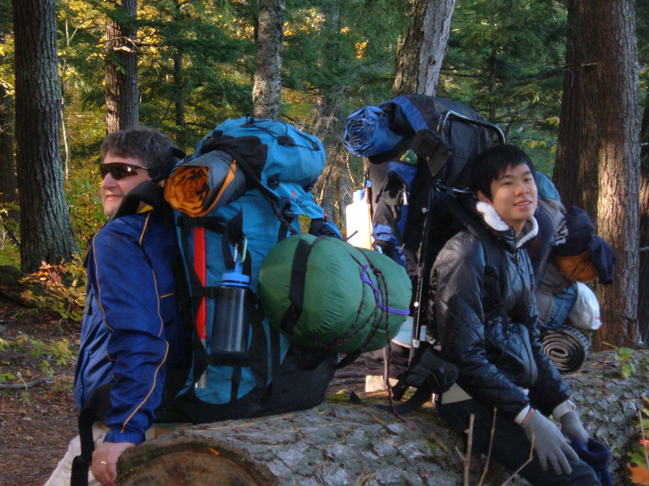

Slide 70
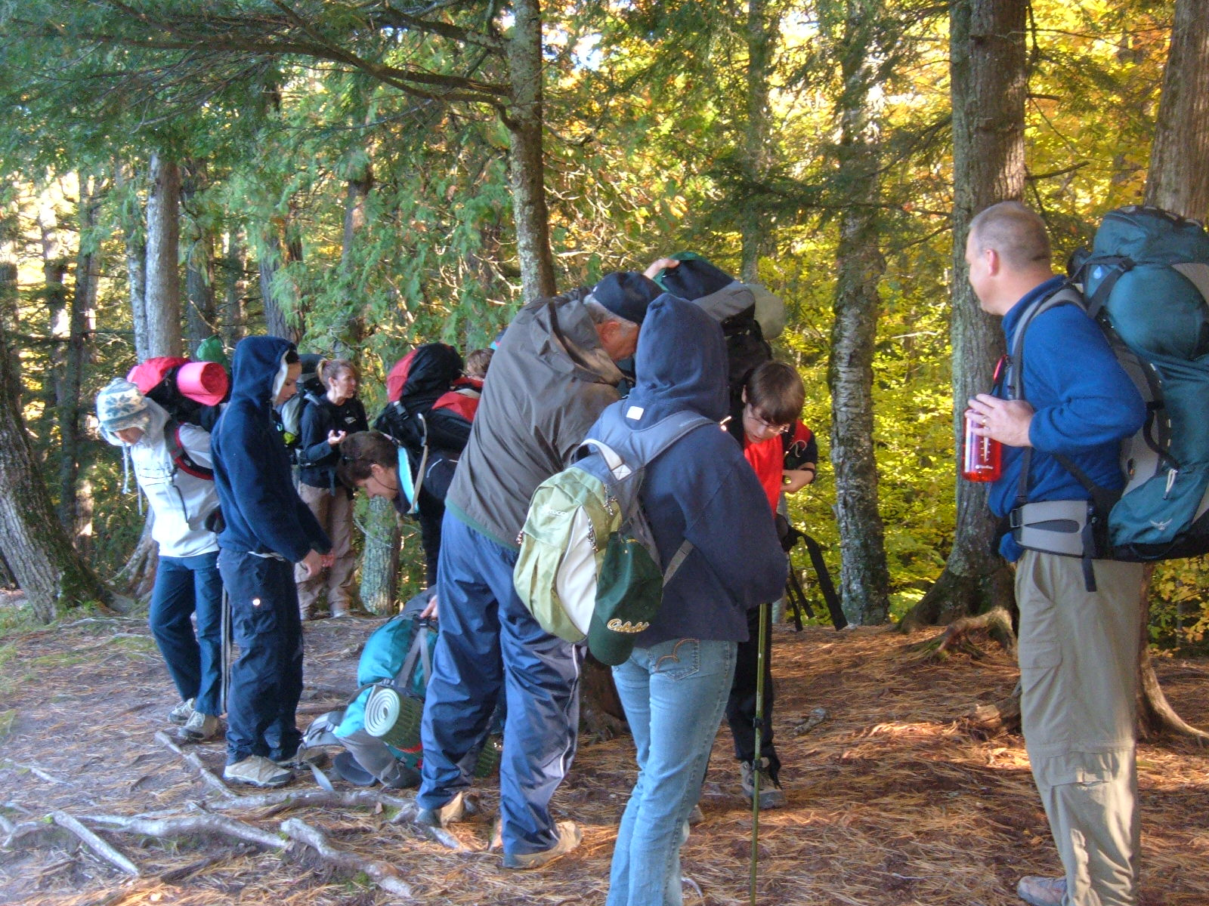

Slide 71
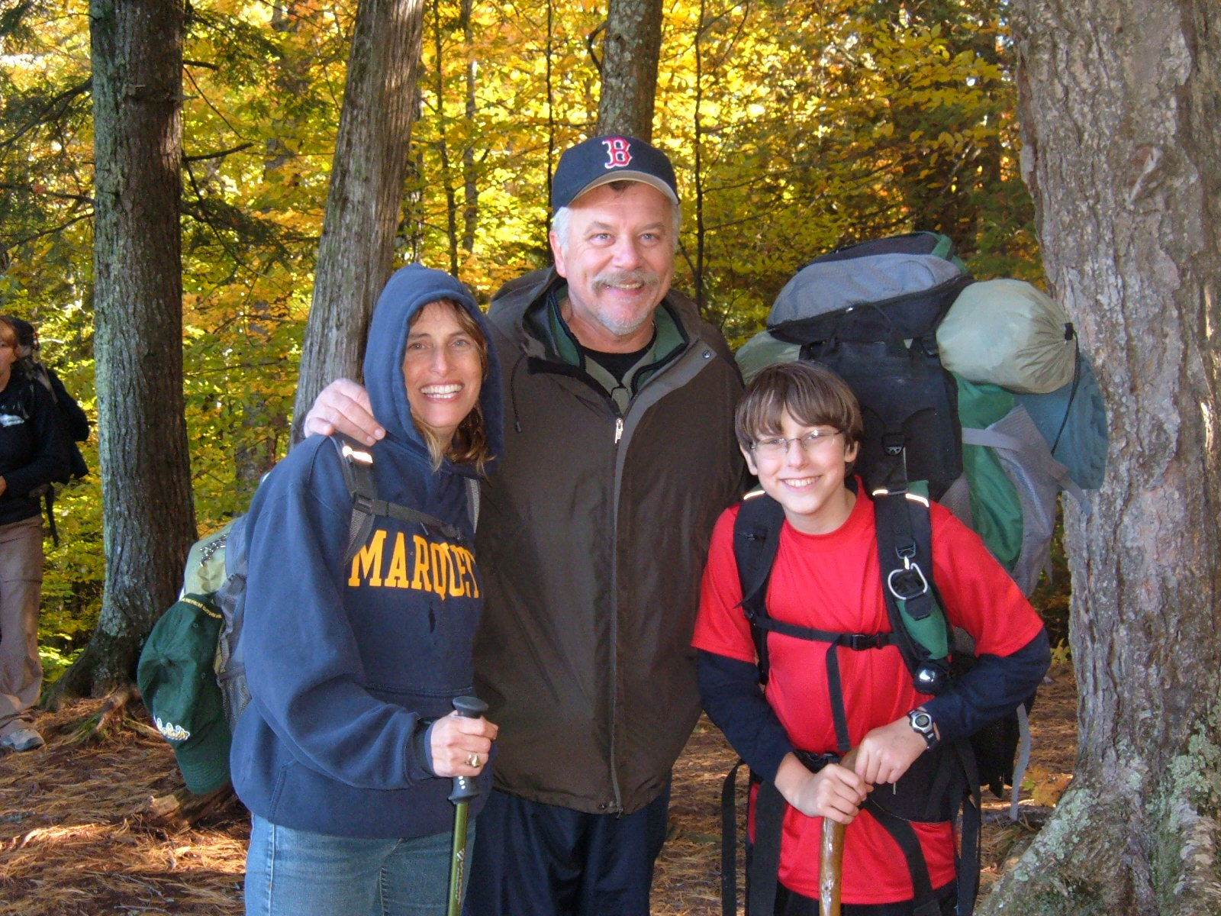

Slide 72
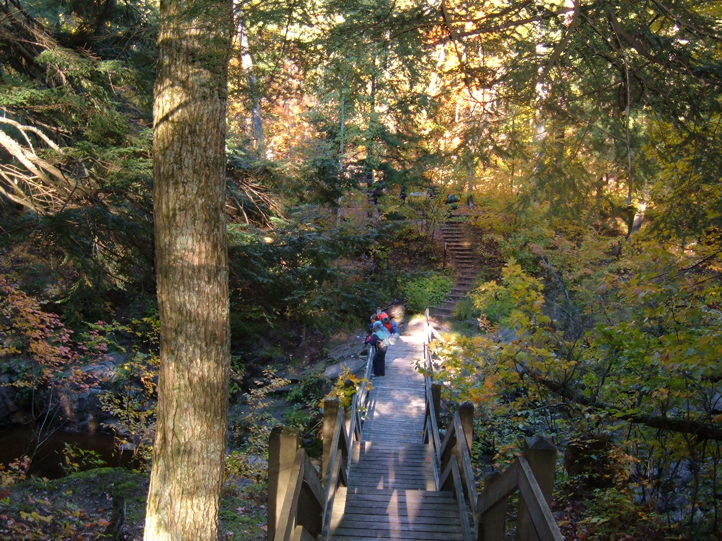

Slide 73
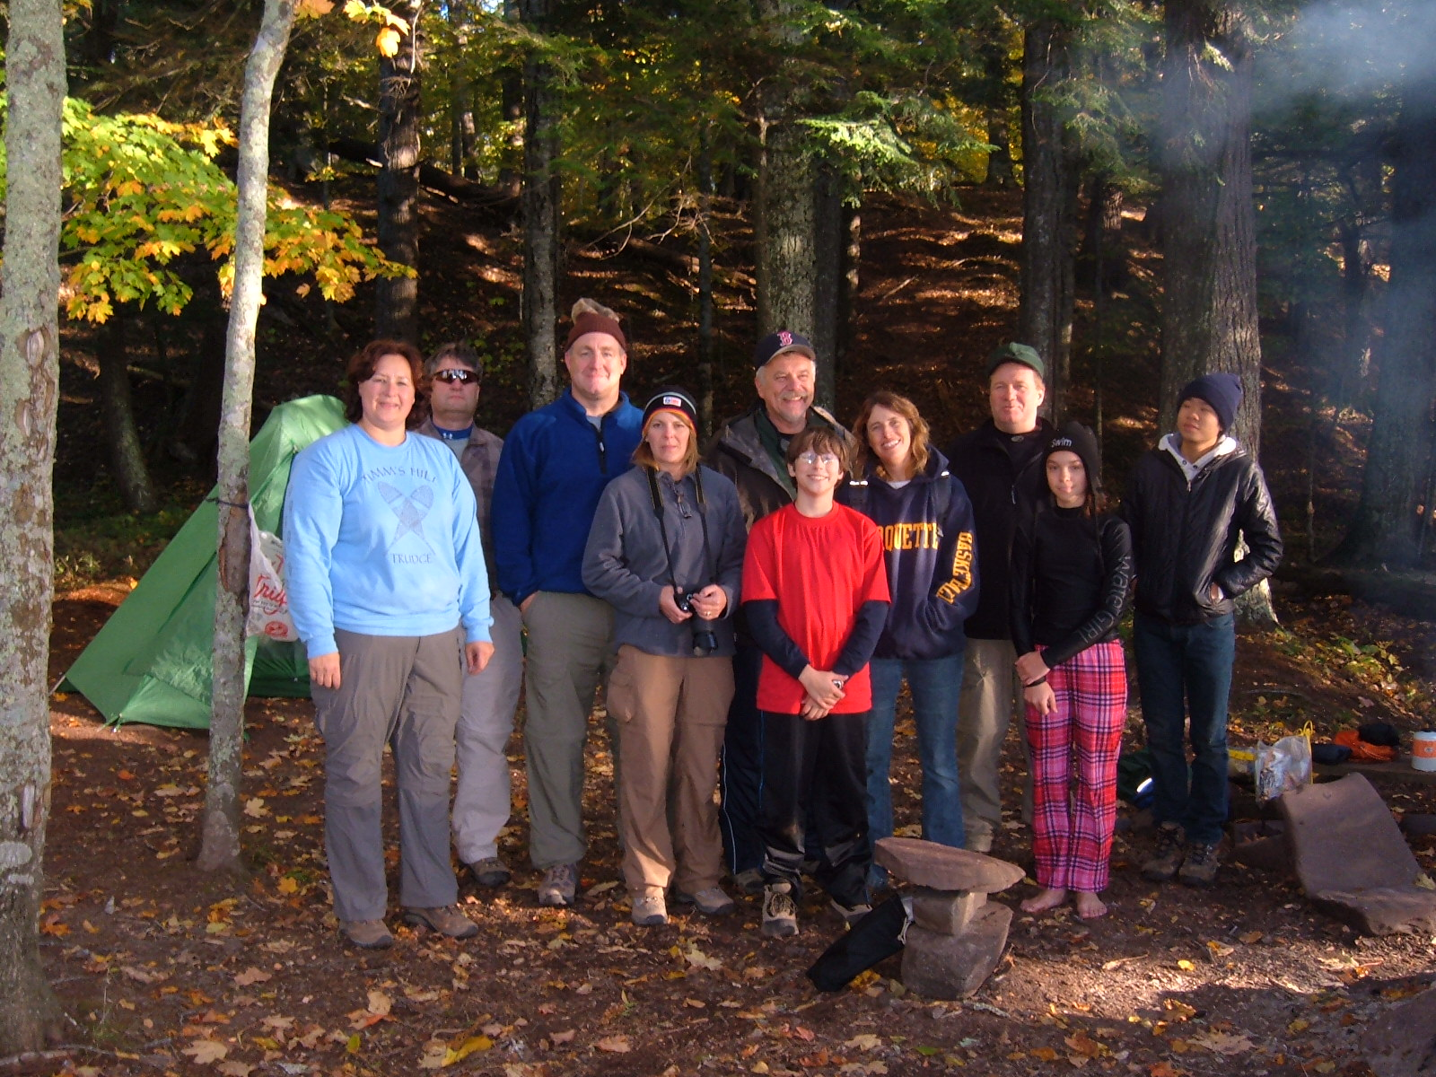

Slide 74
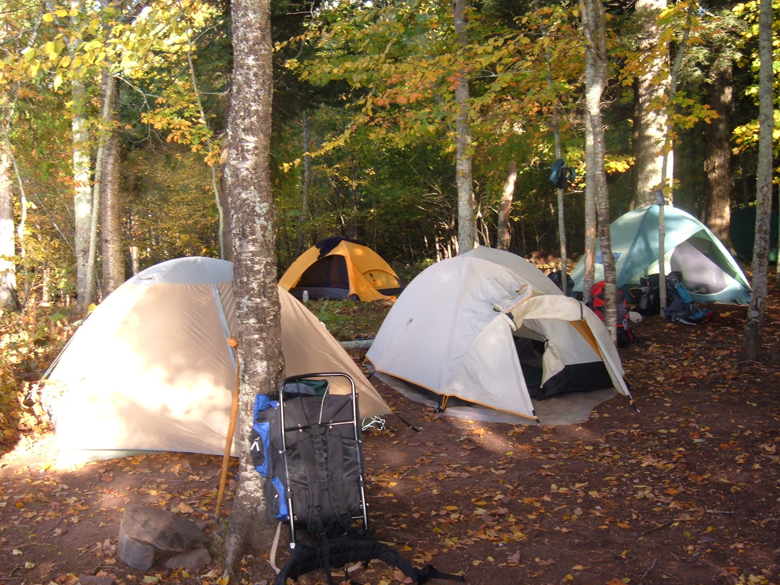

Slide 75
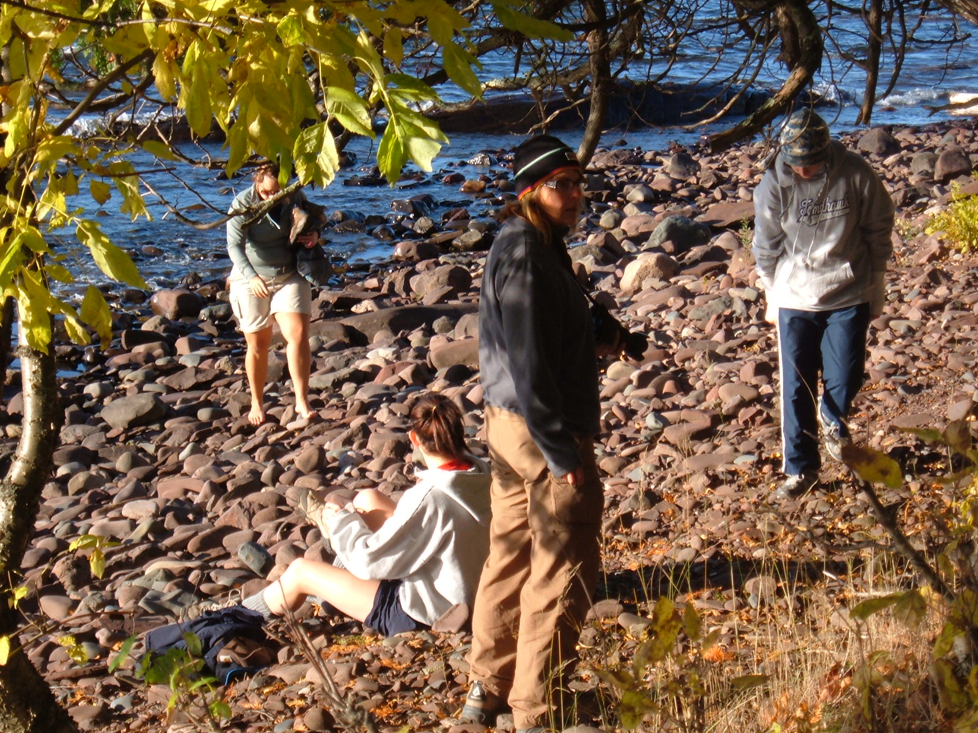

Slide 76
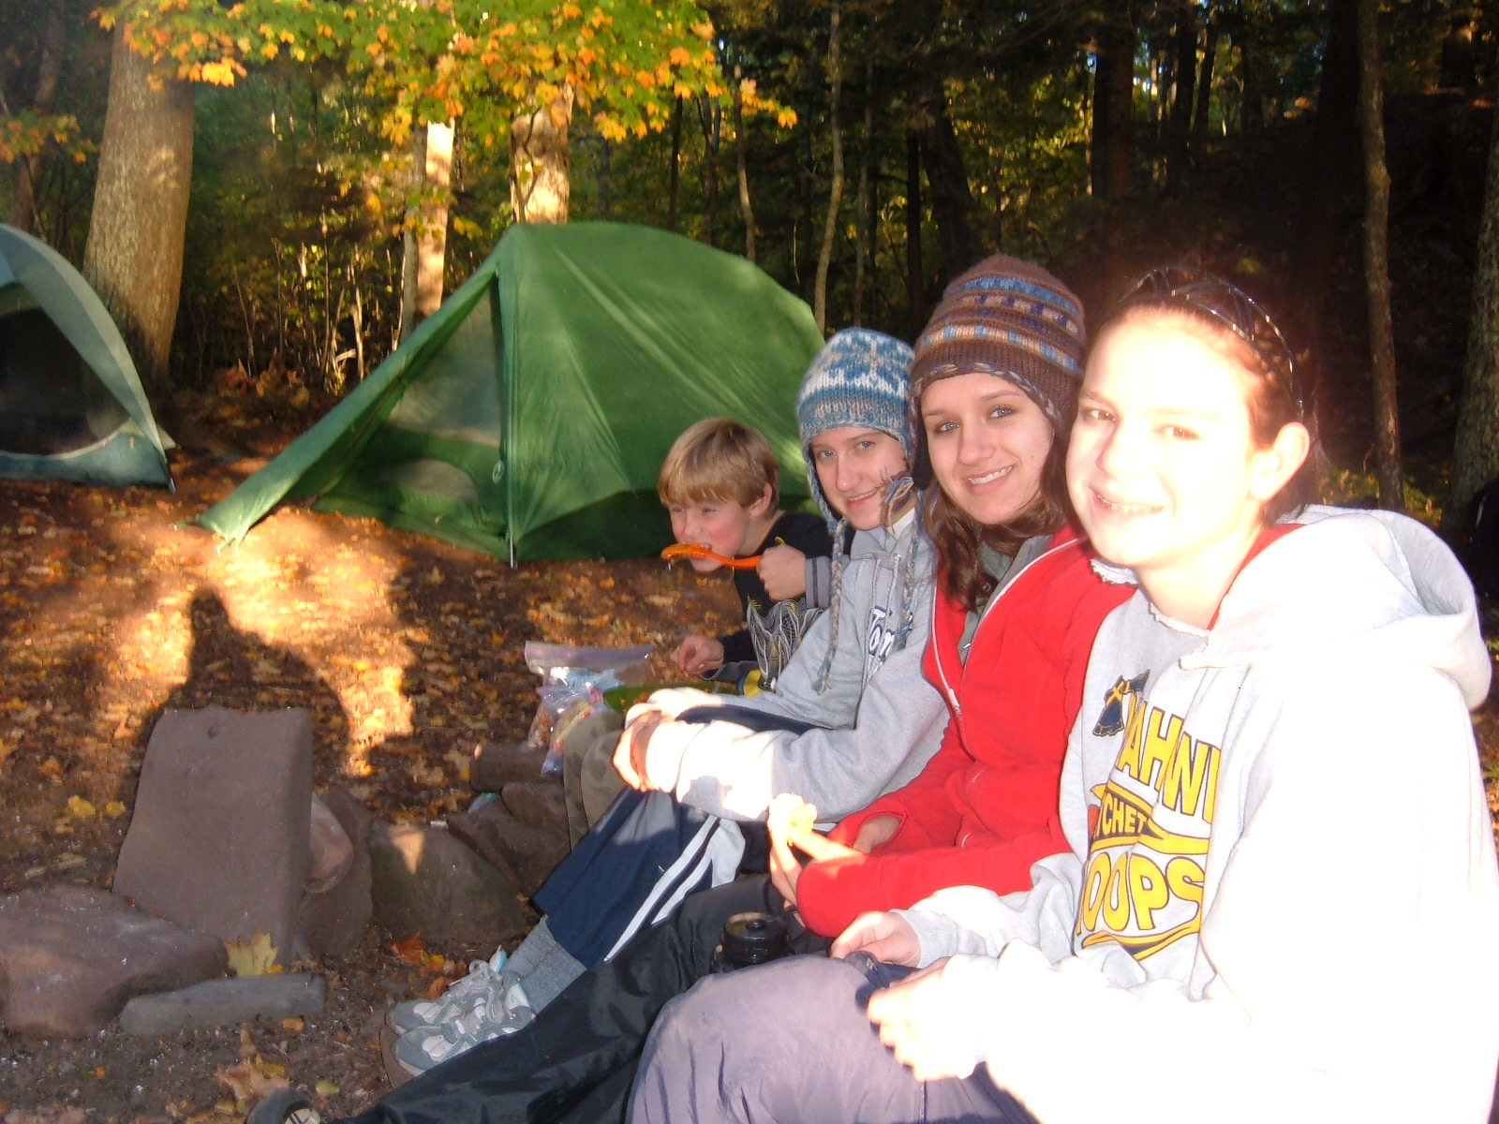

Slide 77


Slide 78


Slide 79


Slide 80


Slide 81


Slide 83


Slide 84
Many opportunities to come:

Slide 85


Slide 86


Slide 87


Slide 88


Slide 89


Slide 90


Slide 91


Slide 92


Slide 93
Did we say:
Family style

